Slide 1

Reinforcement Learning based Energy Optimization in Wireless Sensor Network
Presented By
Shubham Kumar
Electronics & Communication Engineering
Guided By
Prof. Bharat Gupta
Electronics & Communication Engineering
Department of Electronics and Communication Engineering National Institute Technology
Patna 800005

Slide 2
Presentation Outline
Background – context of mining and fatalities statistics
Causes of Fatalities – main culprits of mining fatalities
Literature Review – overview of existing clustering and routing protocols
Motivation & Problem Statement – challenges of energy imbalance and lack of adaptability
Overview of DEEC Protocol – difference between LEACH and DEEC & its algorithm at glance
Overview of Reinforcement Learning – basics of RL and Q-Learning in decision-making
Simulation Results – demonstration of optimal policy learning and acheive the objectives
Conclusion – key findings : Q-Learning improves adaptability and energy efficiency
Future Work – extensions with EEKA, K-mean and hyperparameter tuning

Slide 3
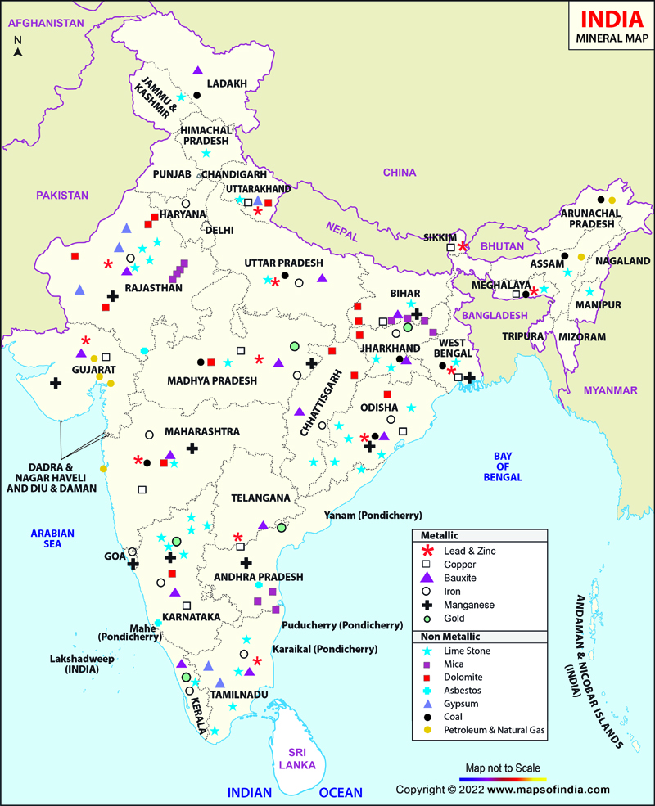
Background
Mining Industry: The India’s major mining regions are Jharkhand, Odisha, Chhattisgarh, Madhya Pradesh and Karnataka[1].
Common Risks[2]:
Gas leaks
Explosions
Roof collapses
Equipment Failures
India’s mining sector[1]:
Non Metallic mines (53 operational)
Depth: Typically from 200 m to 600 m.
Length: Typcally 2km to 4km.
Metallic mines (182 operational)
Depth: Typically from 1km to 4km.
Length: Typcally 2km to 5km.
Data Source: DGMS [1]

Slide 4
Mining Fatalities Statistics
Data Source: DGMS [1]
Data Source: DGMS [1]
Over the 15 year period (2010 to 2025), total mine accidents reported is around 20,025 which leads to total deaths of 49,615[1].
Globally, the annual number of fatal mining accidents is estimated to be in range of 300 to 400[1].

Slide 5
Causes of Mining Fatalities
Gas Accumulation (Methane, Carbon Monoxide, Hydrogen Sulfide): If sensors die due to low energy, gas levels go undetected, leads to explosions or suffocation which can be fatal[3].
Rock Falls/Roof Collapse:Vibration and structural stability sensors must operate continuously. If node energy depletes, blind spots occur and critical incidents happens[3][4].
High Temperature and Humidity Build-Up: Extreme underground heat can cause heat stroke, equipment malfunction and fire[4].
Communication Failures During Emergencies: Breakdown in communication prevents alerts from reaching control rooms. Most communication failures occur due to energy depleted sensor nodes or unstable routing[4].
In underground mines, sensing systems often fail early when WSN nodes rapidly run out of energy. By improving energy efficiency, these networks can provide continuous monitoring and timely alerts, which reduces the risk of fatalities.

Slide 6
Literature Review
Sl | Paper & Year | Optimization Technique Used | N/w Lifetime Improved | Limitations / Research gap
1 | Al-Kaseem et al. (2021) Optimized Energy-Efficient Path Planning with Multiple Mobile Sinks[5] | Ant Colony Optimization + Genetic Algorithm | 66% vs. standard LEACH | Heavy computation demand Static environment
2 | Raed et al. (2022) Efficient Energy Mechanism for Underground Mining Monitoring[6] | Enhanced LEACH + DEECP | 25% vs standard LEACH | No mobility support Static environment
3 | Salman et al. (2022) Optimization of LEACH Protocol for WSNs in Terms of Energy Efficiency and Network Lifetime[7] | Particle Swarm Optimization | 30% vs. standard LEACH | No mobility support Non heterogeneous environmnt
4 | Gamal et al. (2022) Enhancing Lifetime of WSNs Using Fuzzy Logic LEACH and Particle Swarm Optimization[8] | Fuzzy + Particle Swarm Optimization | 18% vs. standard LEACH | Increased control overhead from fuzzy inference
5 | Mohapatra et al. (2022) Mobility Induced Multi-Hop LEACH Protocol in Heterogeneous Mobile Network[9] | Modified multi-hop LEACH | 20% vs. standard LEACH | Assumes uniform mobility Non heterogeneous environmnt

Slide 7
Literature Review
Sl | Paper & Year | Optimization Technique Used | N/w Lifetime Improved | Limitations / Research gap
6 | Botao Zhu et al. (2022)UAV Trajectory Planning in Wireless SensorNetworks by Deep Reinforcement Learning[10] | Used Deep Q-Network using neural network | Better Routing | Centralize control Computation heavy
7 | Tadele A. Abose et al. (2023) Optimized Cluster Routing Protocol With Energy-Sustainable Mechanisms for Wireless Sensor Networks[11] | Stable Election Protocol | 36% vs standard LEACH | No Multi-hopping Homogenous network
8 | Saikat Chandra et al. (2024) LoRa-Based IIoT Network for Underground Coal Mine Environment[12] | Used LoRa to perform P2P communication | N/A | Clustering is missing
9 | Aleem & Thumma (2025) Hybrid DEEC EEKA RL in IoT- WSNs[13] | Residual energy ratio (DEEC) EEKA constraints + RL | 17.5% vs standard LEACH | Computational overhead, No mobility support
10 | Chaudhari, A., Deshpande (2025) Energy‑efficient Q‑learning-based routing in wireless sensor networks[14]. | Q-Learning + Optimized routing | 50% vs baseline Q-Learning | No multi-hop routing No comparison with classical protocols

Slide 8
Motivation & Problem Statement
Motivation:
Continuous sensing is critical in underground mines.
Sensor nodes die early due to limited battery.
Blind spots form, increasing accident risk.
Energy efficient nodes ensure reliable monitoring and worker safety.
Problem Statement:
Existing protocols such as LEACH and DEECP rely on static, heuristic-based cluster head selection and does not exploit node heterogeneity which leads to uneven energy consumption and premature node death. This reduces network lifetime compromises continuous monitoring in underground mines.
Objective:
Improve DEEC protocol by integrating Q-Learning (a part of reinforcement learning) for intelligent cluster head selection.
Achieve improvement in network lifetime by reducing premature node deaths and energy imbalance.

Slide 9
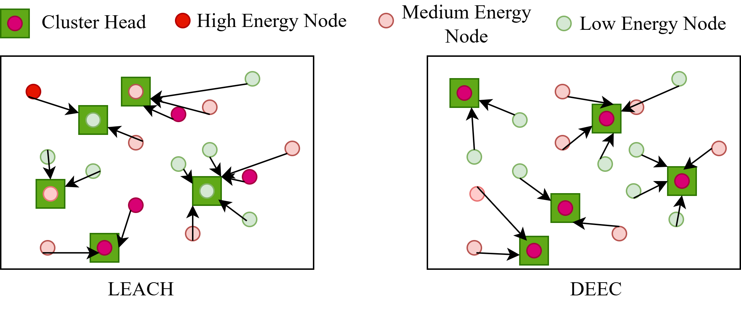
Overview of DEEC Protocol
DEEC(Distributed Energy-Efficient Clustering): It is a hierarchical routing protocol designed to maximize the lifetime of a WSN by balancing energy consumption among nodes[6].
The Core Problem It Solve: The "Energy Hole", in many protocols (like LEACH), CHs are chosen randomly and not chosen in recent past, which leads nodes with low energy to become CHs and they die quickly.
Energy Aware Clustering: DEECP incarporates CH selection is based on a node's remaining (residual) energy. Nodes with more energy have a higher probability of being selected as a CH.
Fig 2: LEACH vs DEEC

Slide 10
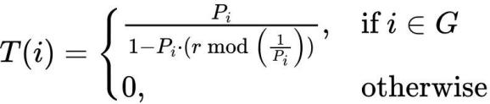
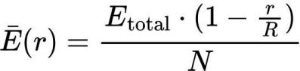
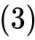
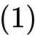
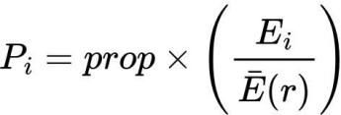
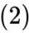
DEEC Algorithm
Starts with a Baseline (p_opt):
The protocol begins with a fixed percentage of nodes that should be CHs in any round (e.g. 5% of all nodes). This ensures network stability[6].
Compares Individual Energy to the Average (E_i / E_avg):
This is the core of the protocol. It calculates a ratio by dividing a node's current energy (E_i) by the estimated average energy of the entire network (E_avg)[6].
The core equations that guide DEECP:

Slide 11
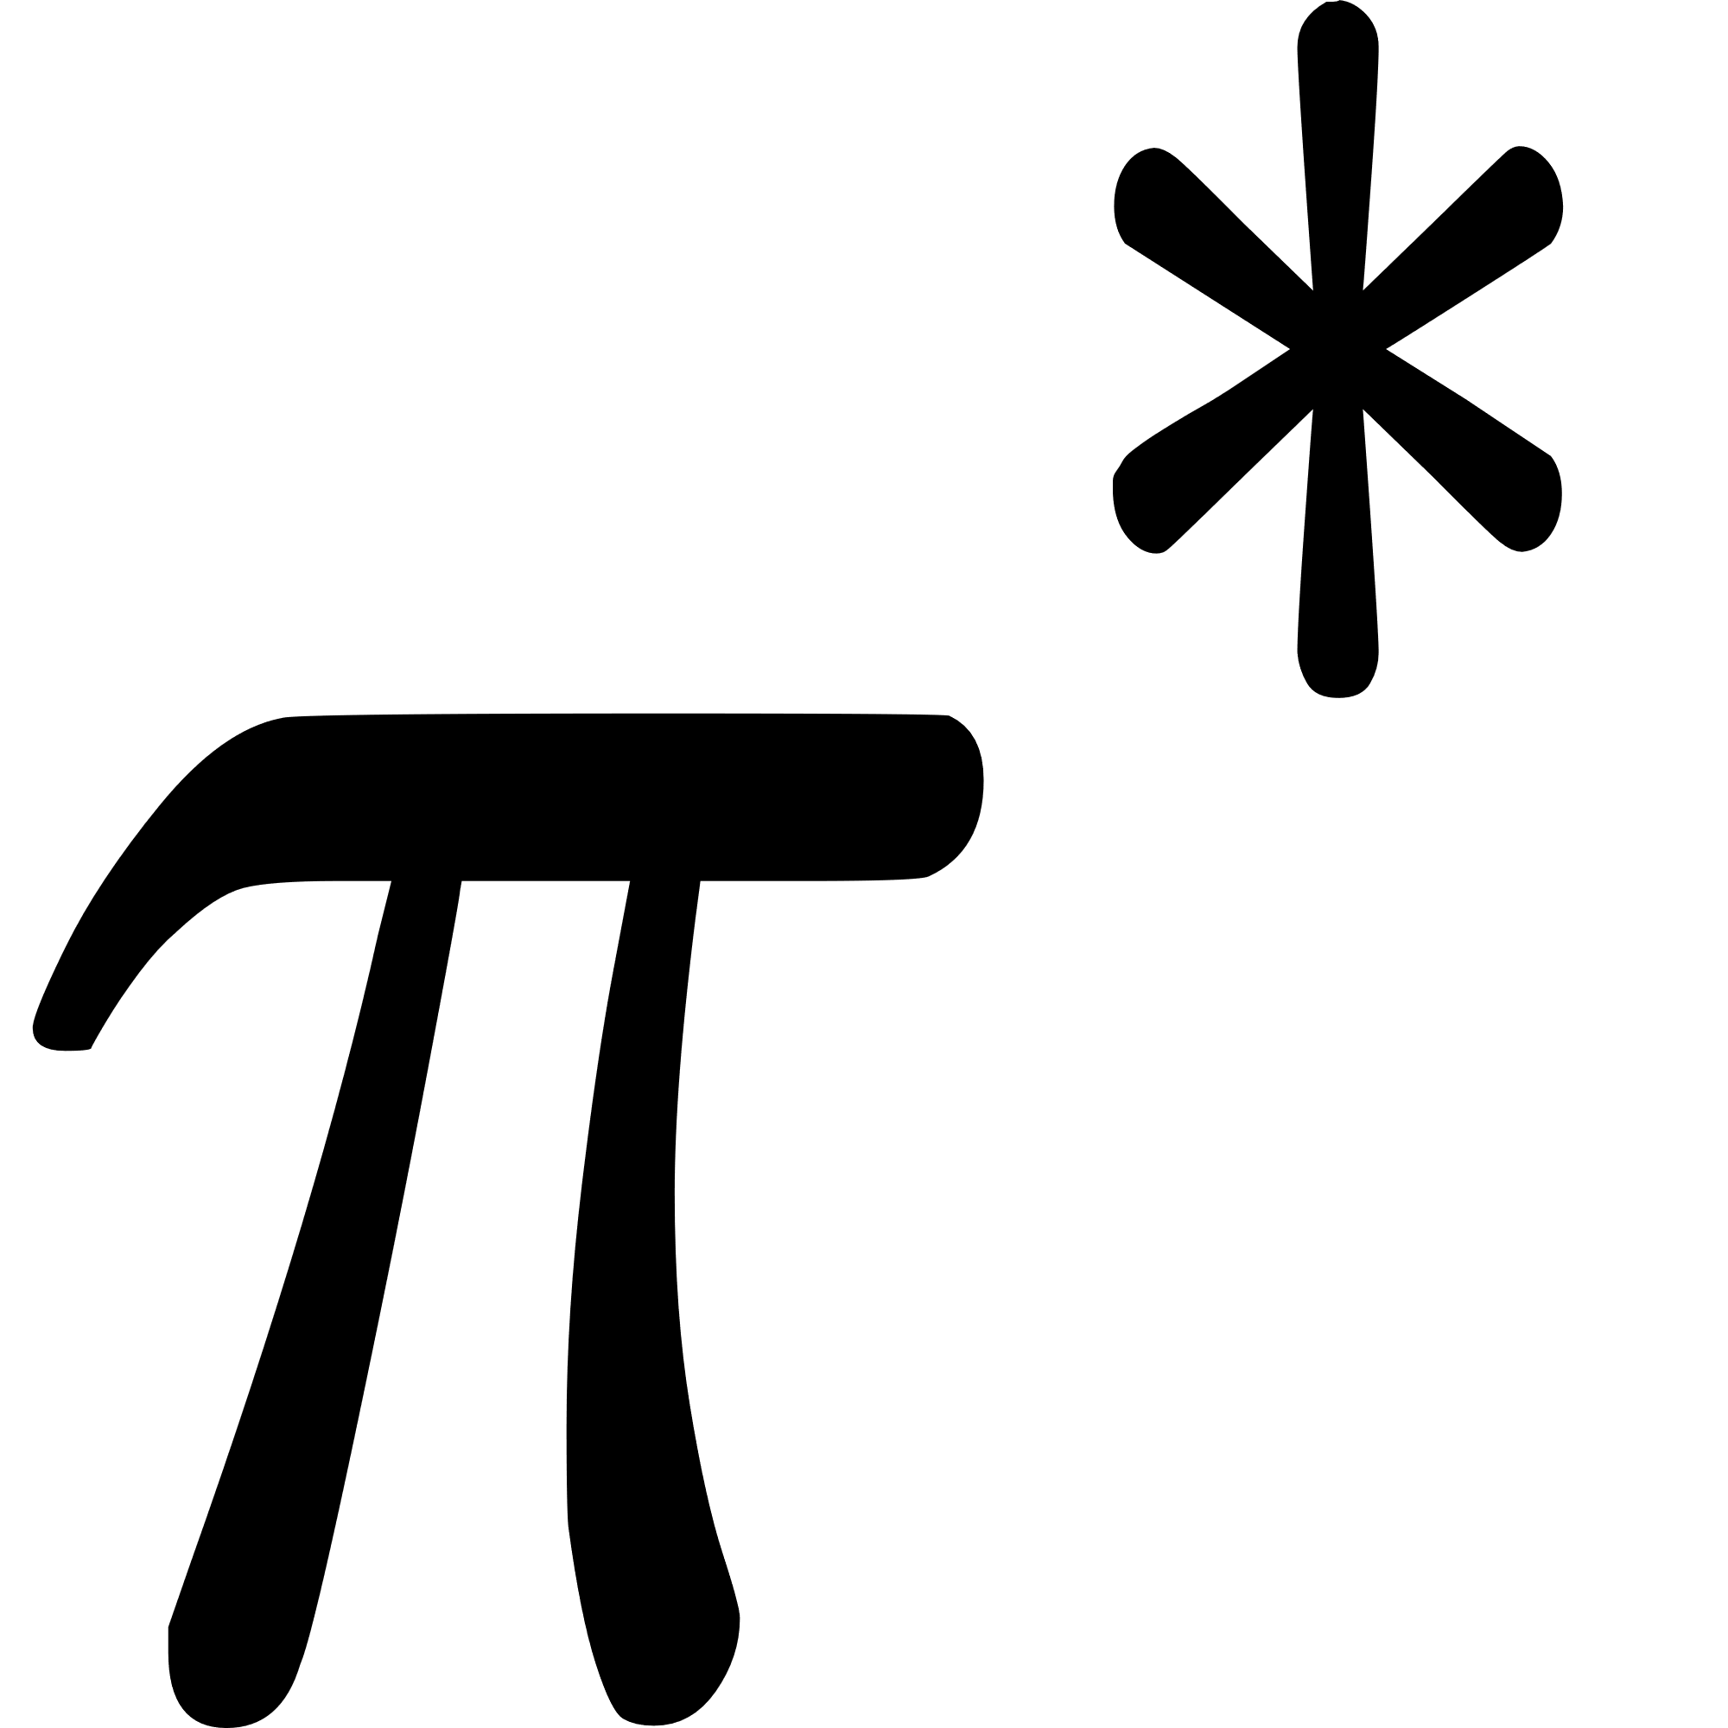
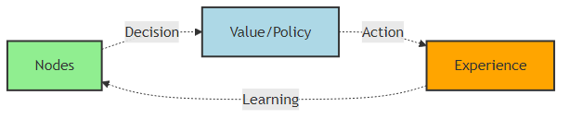
Overview of Reinforcement Learning
Definition: Reinforcement Learning (RL) is a learning paradigm where an agent learns to make decisions by interacting with an environment to maximize cumulative reward[13].
Agent Environment Interaction:
Agent: Makes decisions by taking actions
Environment: Responds with new states and rewards/penalty
Goal: Find an optimal policy that maximizes expected return
Trial-and-Error Learning: Agent explores actions, observes outcomes and updates its strategy iteratively.
Fig 1: Agent learning behavior

Slide 12


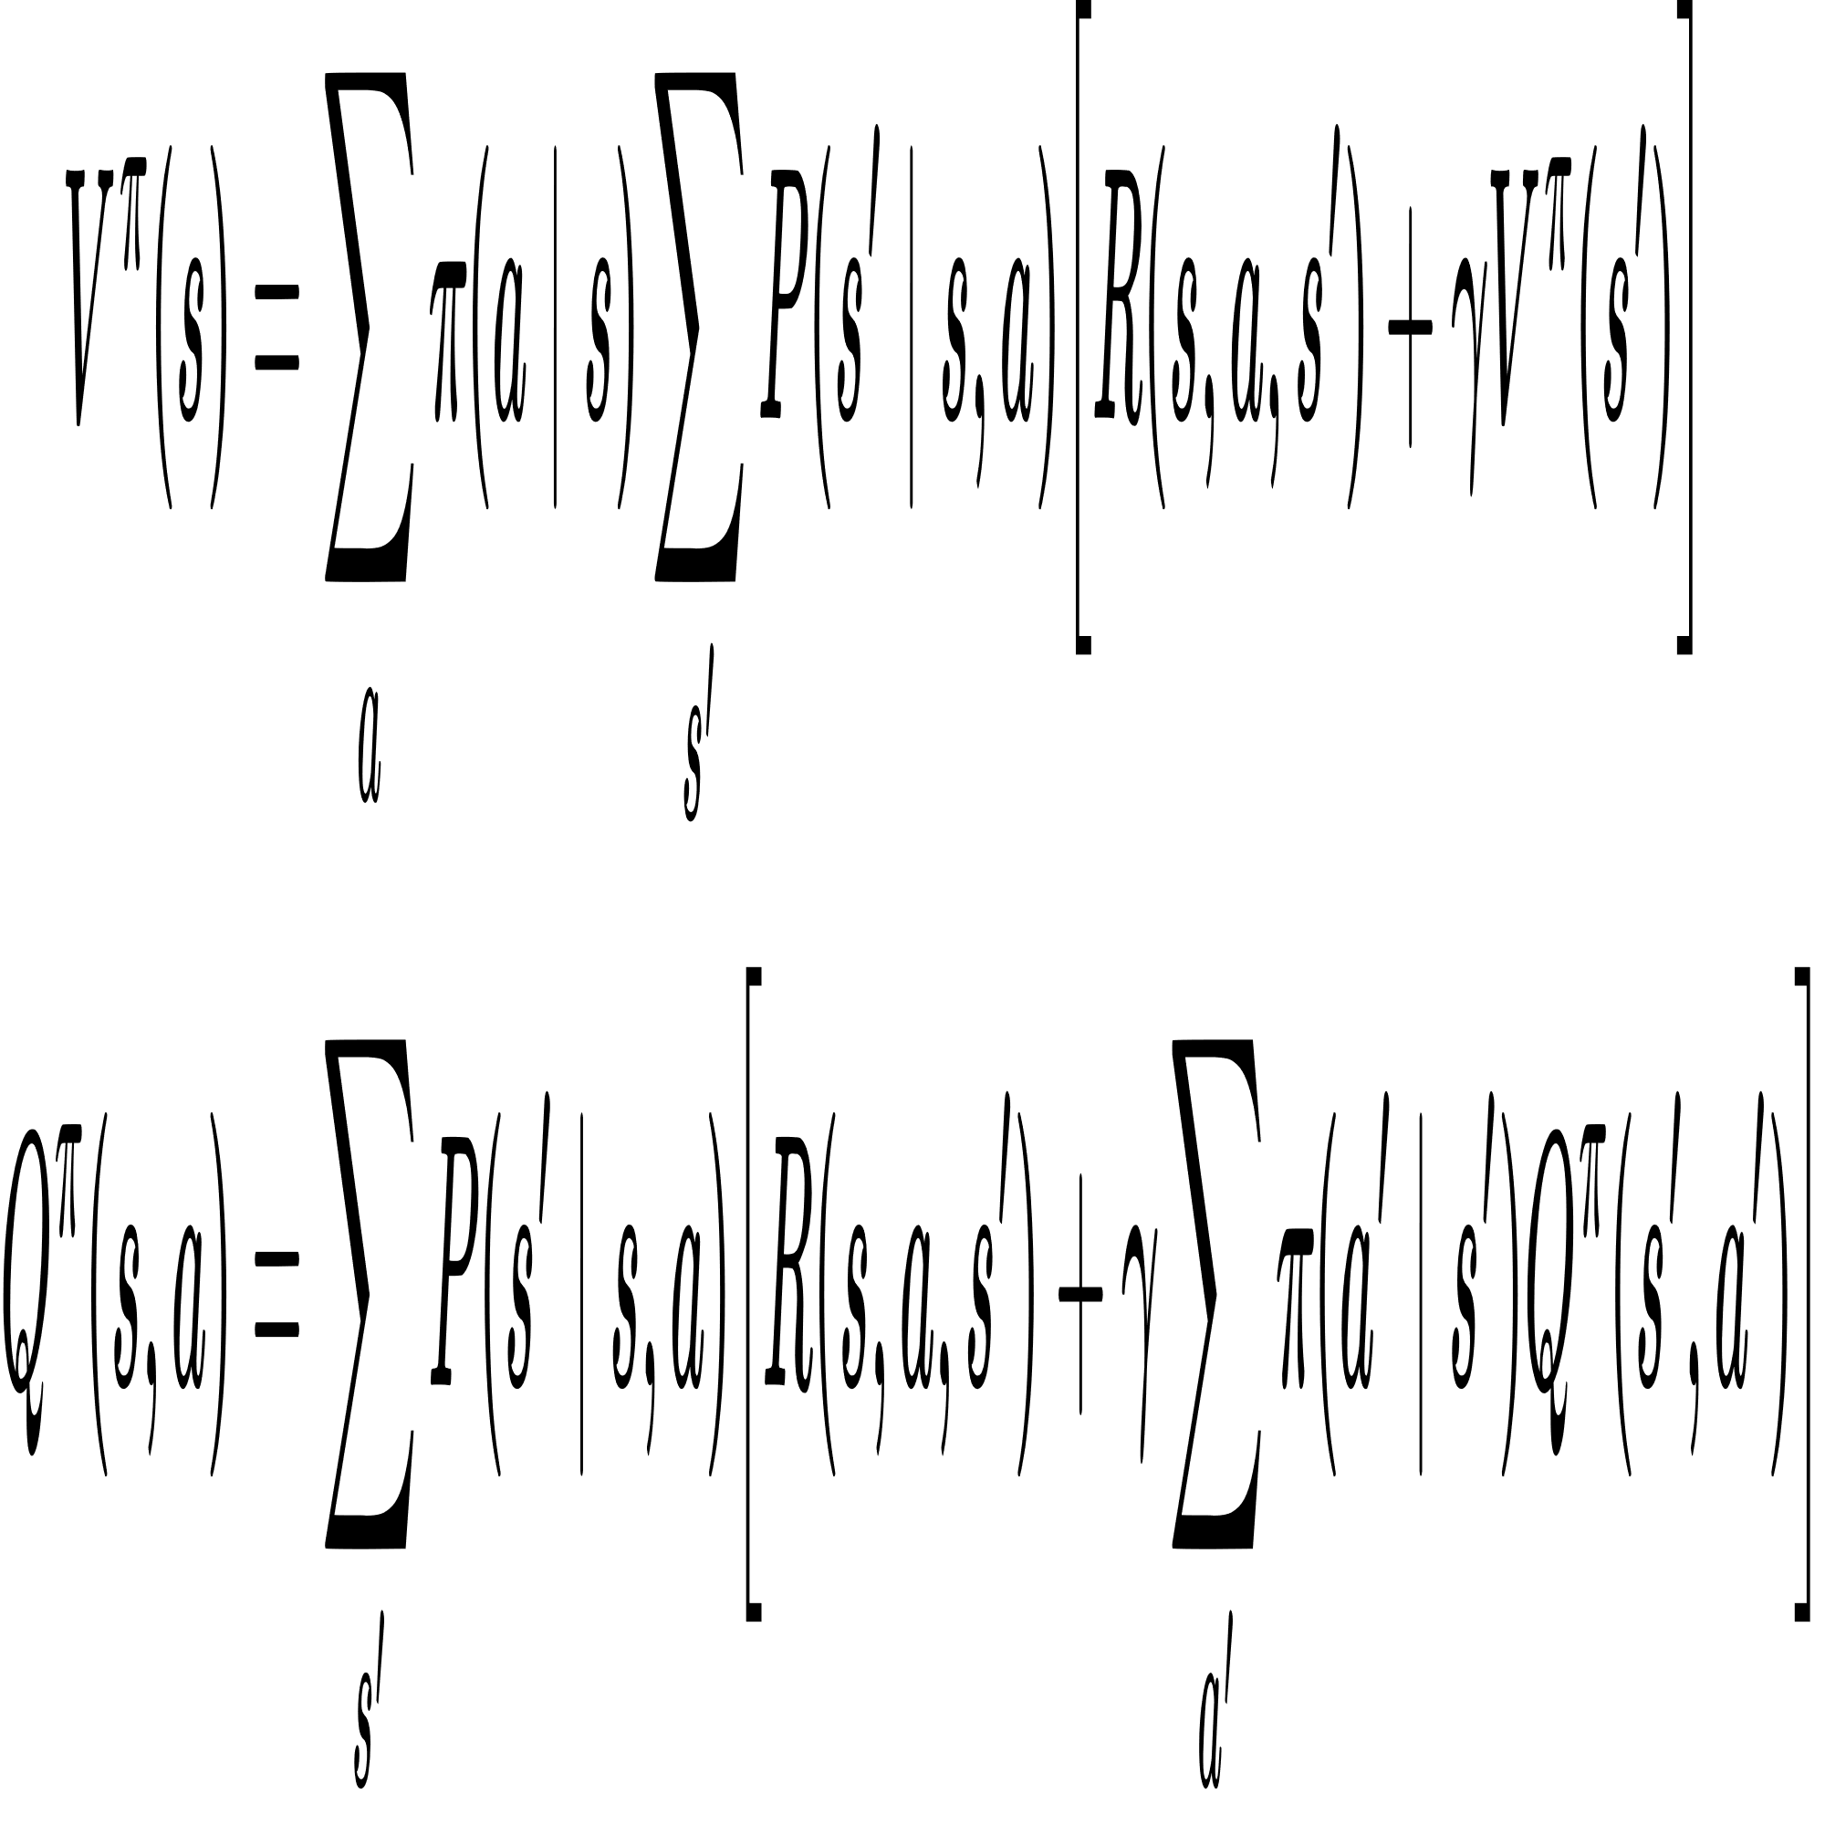
Value Functions and Bellman Equations
State Value Function : It maps expected return under policy 𝜋, using MDP transition probabilities and reward function[14].
Action-Value Function : It maps state-action pairs to expected return based on MDP dynamics. It allows RL to determine which action in a given state is best[14].
Bellman Equations: Encode recursive relationship between the current value of a state and values of successor states using MDP’s transition and reward functions[13],[14].
Use Case: Using these equations, we iteratively compute the optimal state value or optimal policy, as the Bellman equation is bound to converge.

Slide 13
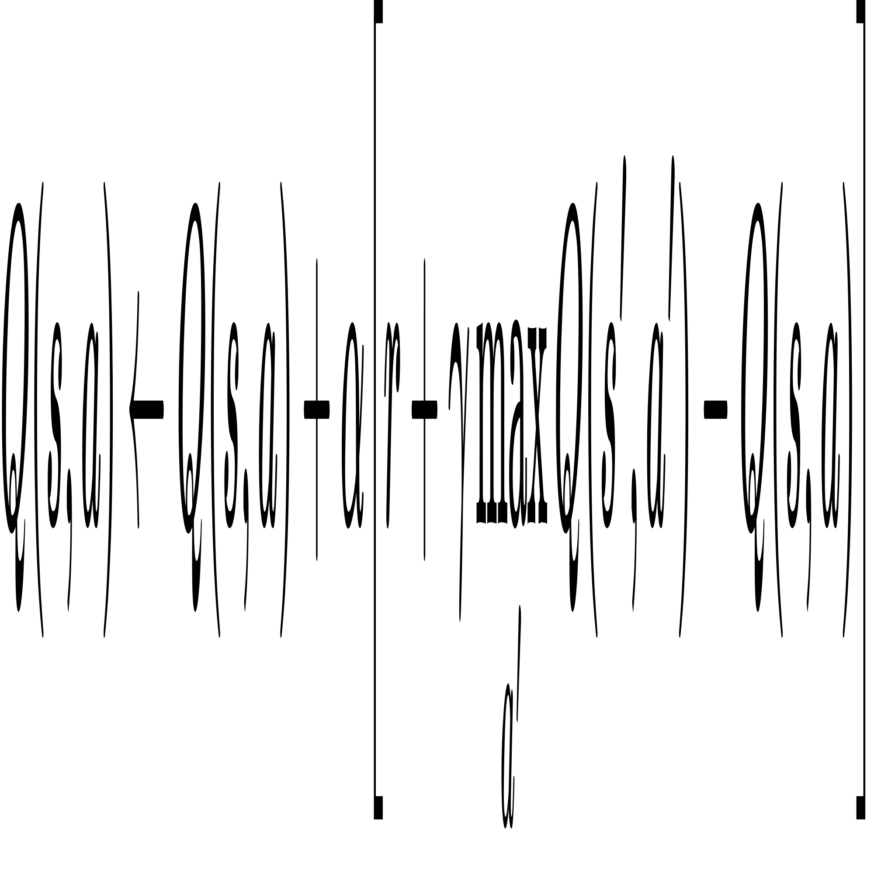
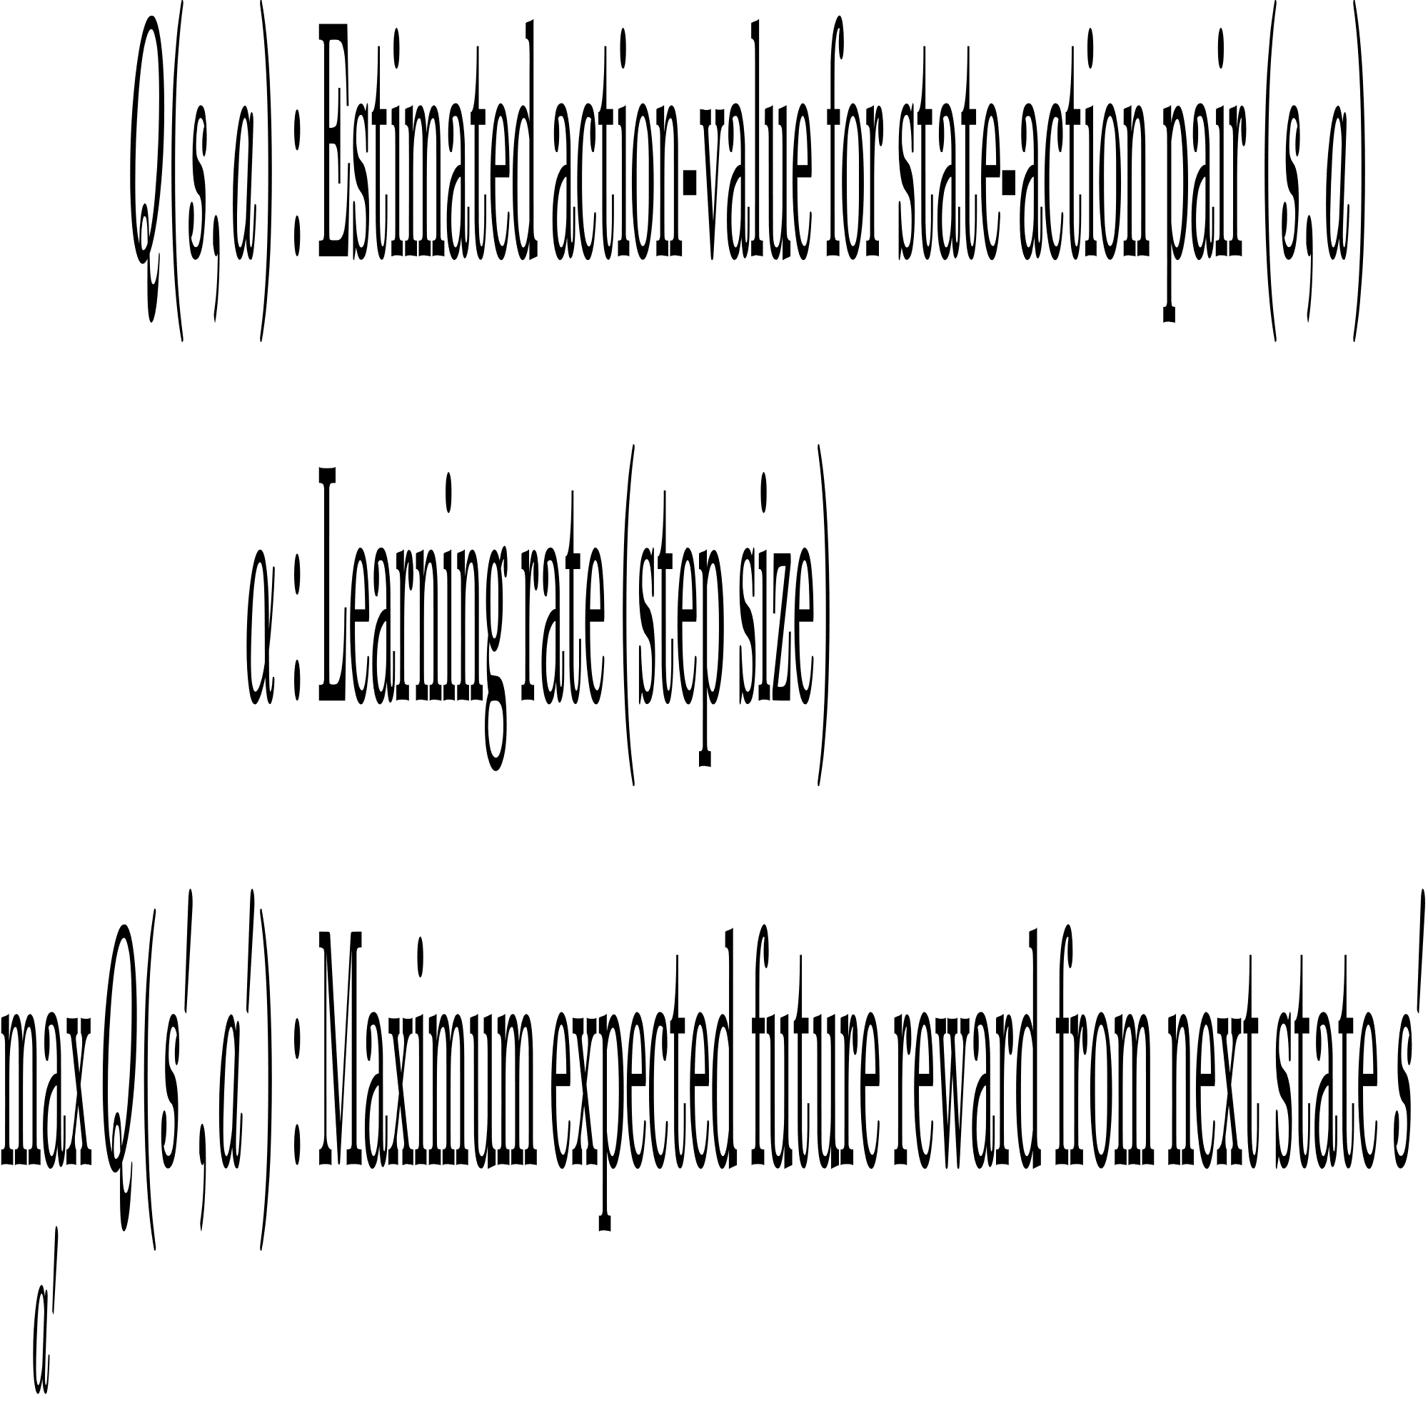
Model Free RL Q-Learning
Overview: Q-Learning enables the agent to learn the optimal action-value function that is 𝑄∗(s,a) through trial-and-error by maintaining a Q-table for all state action pairs.
Q-Learning Update Formula: This iterative formula solves the Bellman optimality equation for action values, allowing direct convergence to the optimal policy[14].
Q-Table: Stores Q(s,a) for all state-action pairs, where rows represent states and columns represent actions, holding expected rewards to guide the agent toward optimal actions[14].

Slide 14
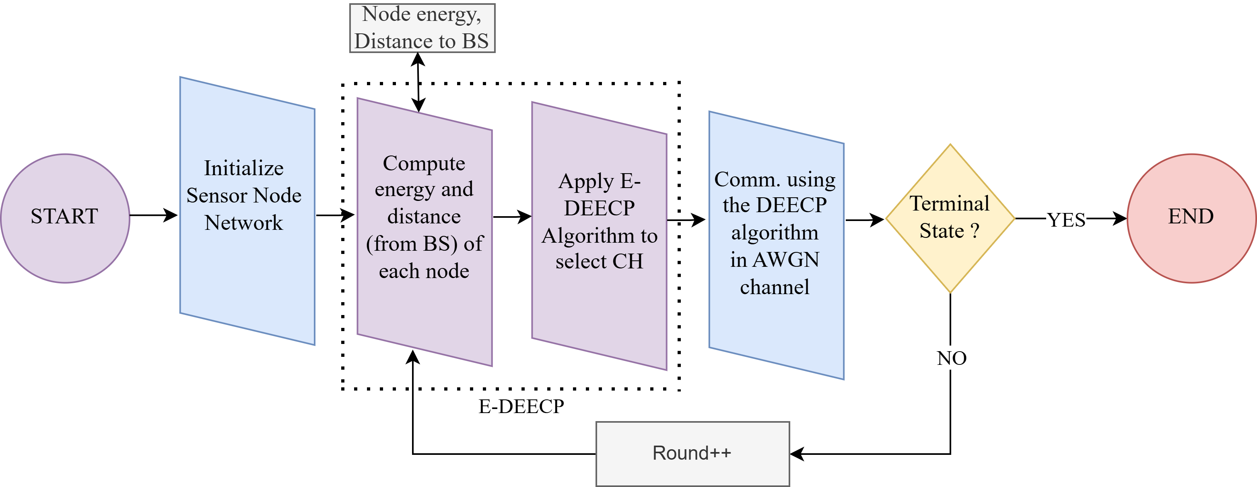
E-DEECP Block Diagram
Fig 3: Block digram of deecp and e-deecp method

Slide 15
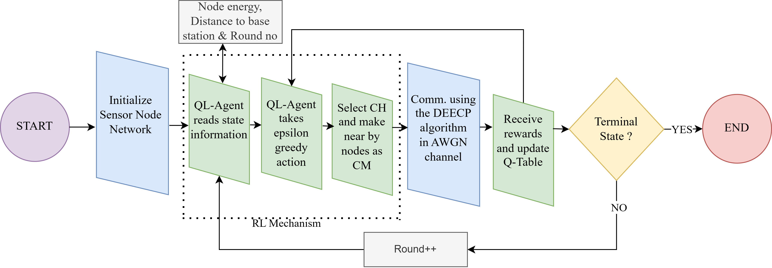
The Methodology
Fig 4: Block digram of QL-DEECP method

Slide 16
The Methodology
Agent reads node state: Remaining energy, Distance to BS and Round number.
Selects action using epsilon-greedy: Explore new CHs or exploit best known CH.
Chooses Cluster Head: Highest valued node becomes CH; others join as CMs.
Communication occurs: Nodes send data to CH, CH aggregates and sends to BS.
Reward is computed: Based on energy consumption, alive nodes, and balanced CH selection.
Q-table updated: Agent learns which node is best suited as CH in future rounds.
Check terminal state: If nodes die stop, else continue to next round.

Slide 17
Simulation Environment
Physical Layer Parameters | Value
Sink (BS) location | Center
Number of nodes | 50
Node mobility | Static
Channel model | AWGN
Sensing/traffic model | Periodic
Network Parameters | Value
WSN area size | 500m x 500m
Initial energy | 0.5 Joules
Packet size | 3000 bits
Data aggregation energy | 5n J/bit/signal
Transmit energy | 50n J/bit
Receive energy | 50n J/bit
Free space loss | 10n J/bit
Multipath loss | 0.0013p J/bit
Simulation Rounds | 10000
Application/Software | Version
Python | 3.11.1
Antigravity | A1

Slide 18
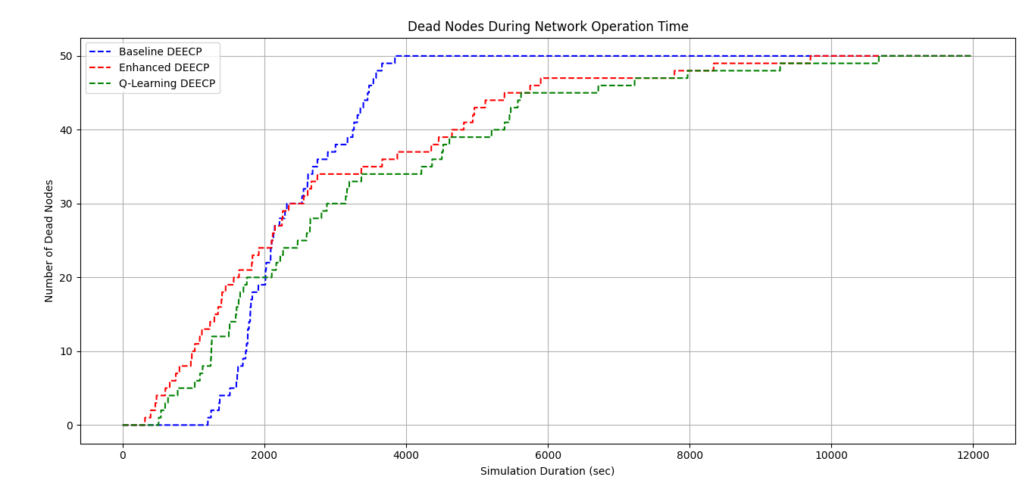
Simulation Results
~3842
~9705
~10700
Fig 5: Network Lifetime for 50 nodes

Slide 19
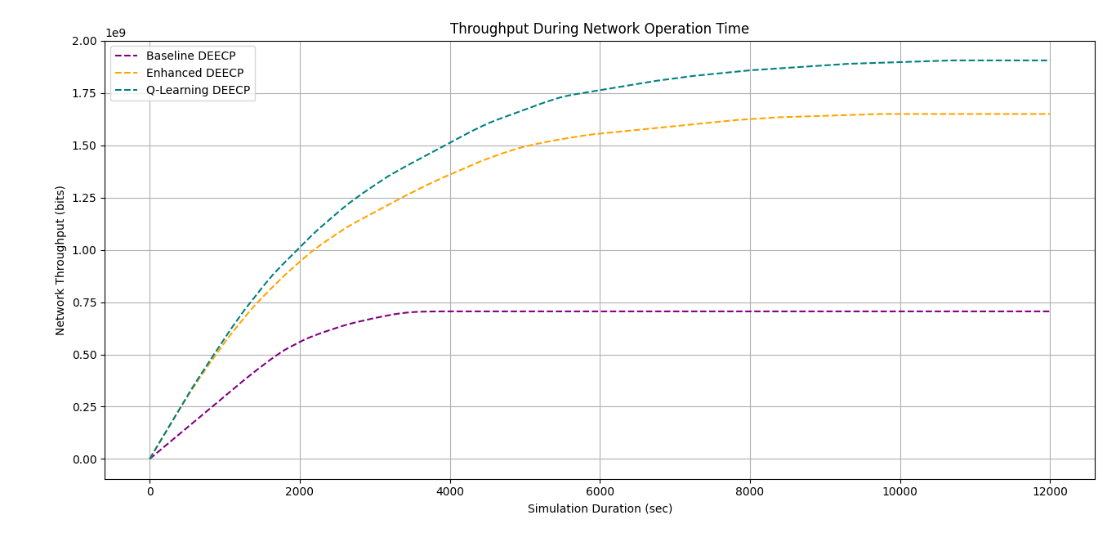
Simulation Results
~13%
~140%
Number of bits
Fig 6: Network Throughput for 50 nodes

Slide 20
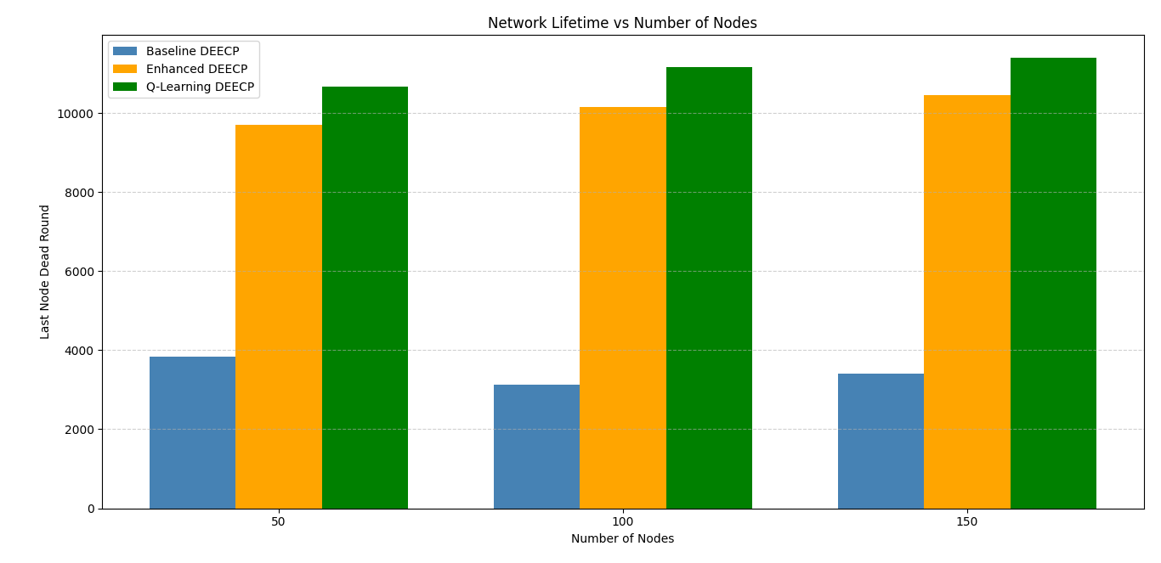
Simulation Results
~11%
~11%
~10%
~150%
~160%
~155%
Fig 7: Network Lifetime Comparision for 50 nodes

Slide 21
Simulation Result Summary
For Number of Nodes = 50
Milestone | Baseline DEECP (rounds) | Enhanced DEECP (rounds) | Q-Learning DEECP (rounds)
1st Node Death | 1203 | 315 | 508
50% Node Death | 2128 | 2117 | 2596
90% Node Death | 3476 | 5749 | 6711
Last Node Death | 3842 | 9705 | 10700
Throughput | 70kbit/sec | 160kbit/sec | 190kbits/sec
QL-DEECP vs Baseline DEECP
+160% Network Lifetime
+140% Throughput
QL-DEECP vs Enhanced DEECP (E-DEECP)
+10% Network Lifetime
+13% Throughput

Slide 22
Conclusion
QL-DEECP achieves the best performance, extending total network lifetime by up to +160% over Baseline and +10% over Enhanced DEECP.
Throughput improves significantly, reaching +140% over Baseline and +13% over Enhanced DEECP.
Q-learning enables adaptive, energy-aware CH selection, reducing premature node deaths and balancing load across the network.
Overall, QL-DEECP provides the most stable, energy-efficient, and high-throughput operation for homogeneous WSNs.

Slide 23
Future Work Motivation
Limitations of QL-DEECP
No spatial cluster optimization
Lacks multi-hop routing
Limited state representation (It does not capture complex features such as node density, cluster load, PDR)
Does NOT support node/BS mobility
No hybrid modeling of channel

Slide 24
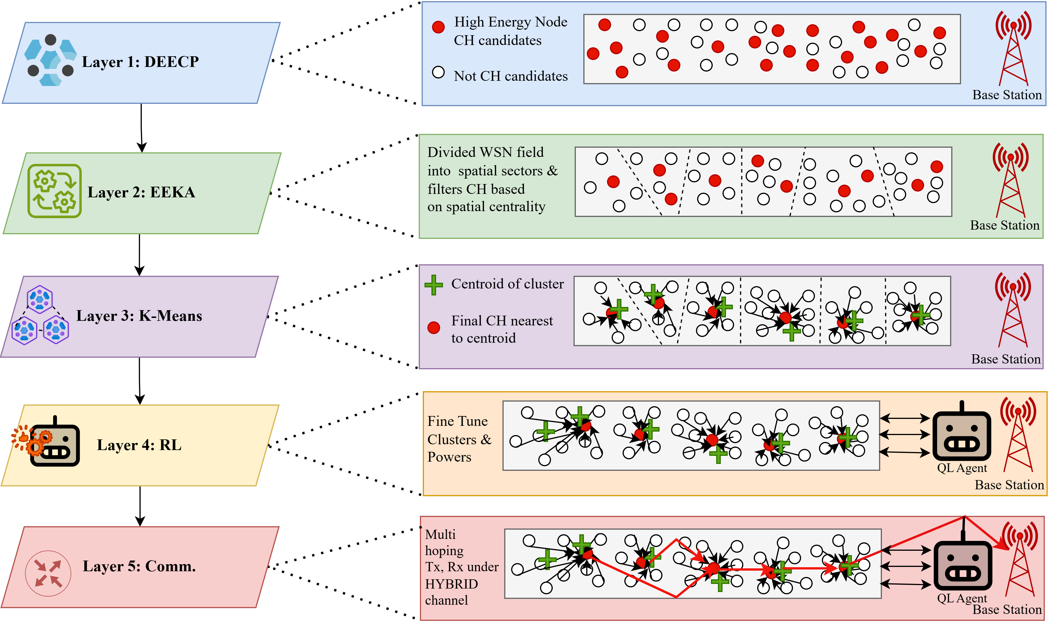
Future Work
Fig 8: Reinforcement Learning driven Hybrid Clustering (RLHC)

Slide 25
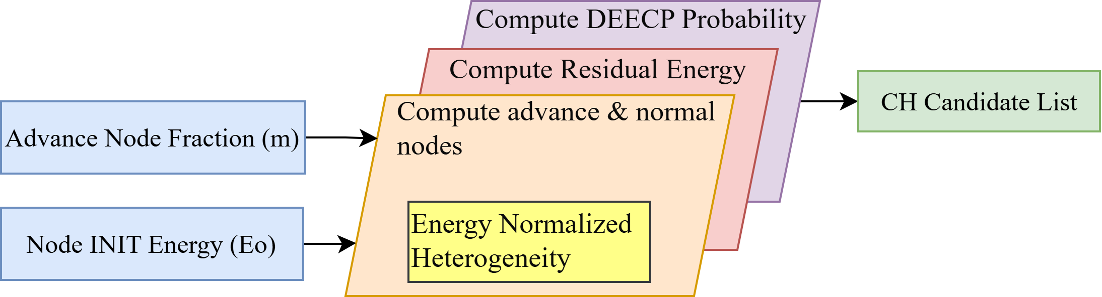
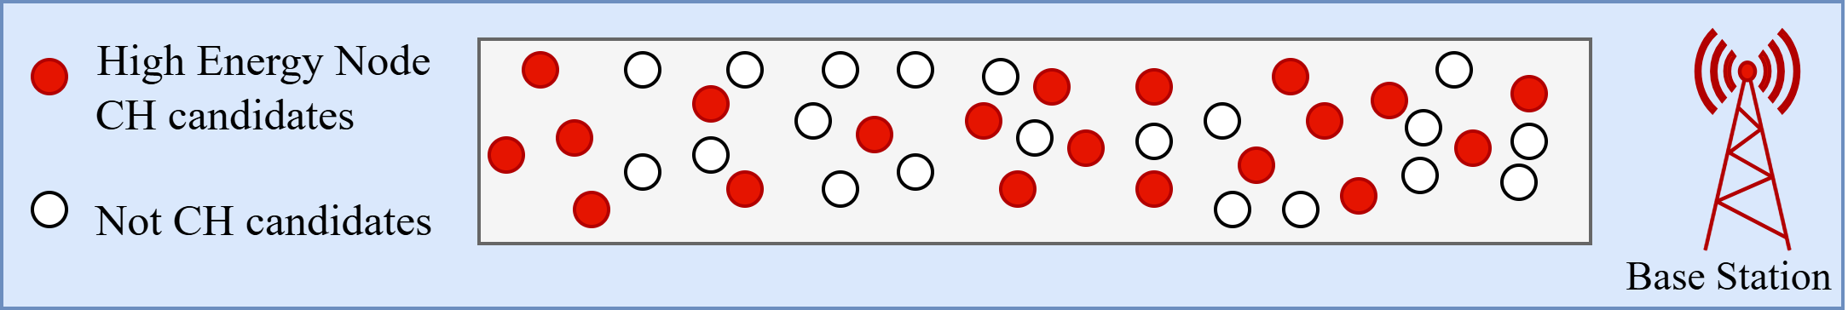
Layer 1: Distributed Energy Efficient Clustering Protocol
Incorporates node heterogeneity.
Provides an energy aware CH list.
The core equations that guide DEECP are:
Fig 9: DEEC Protocol
Fig 8: Candidates cluster heads

Slide 26
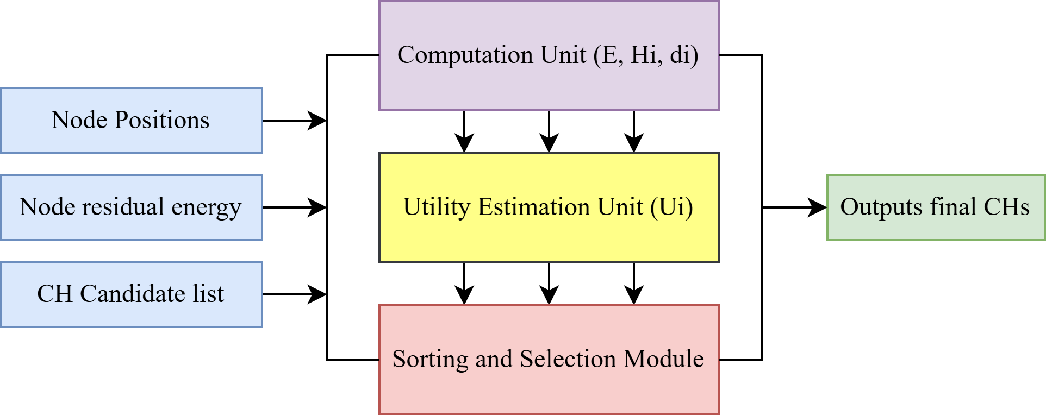
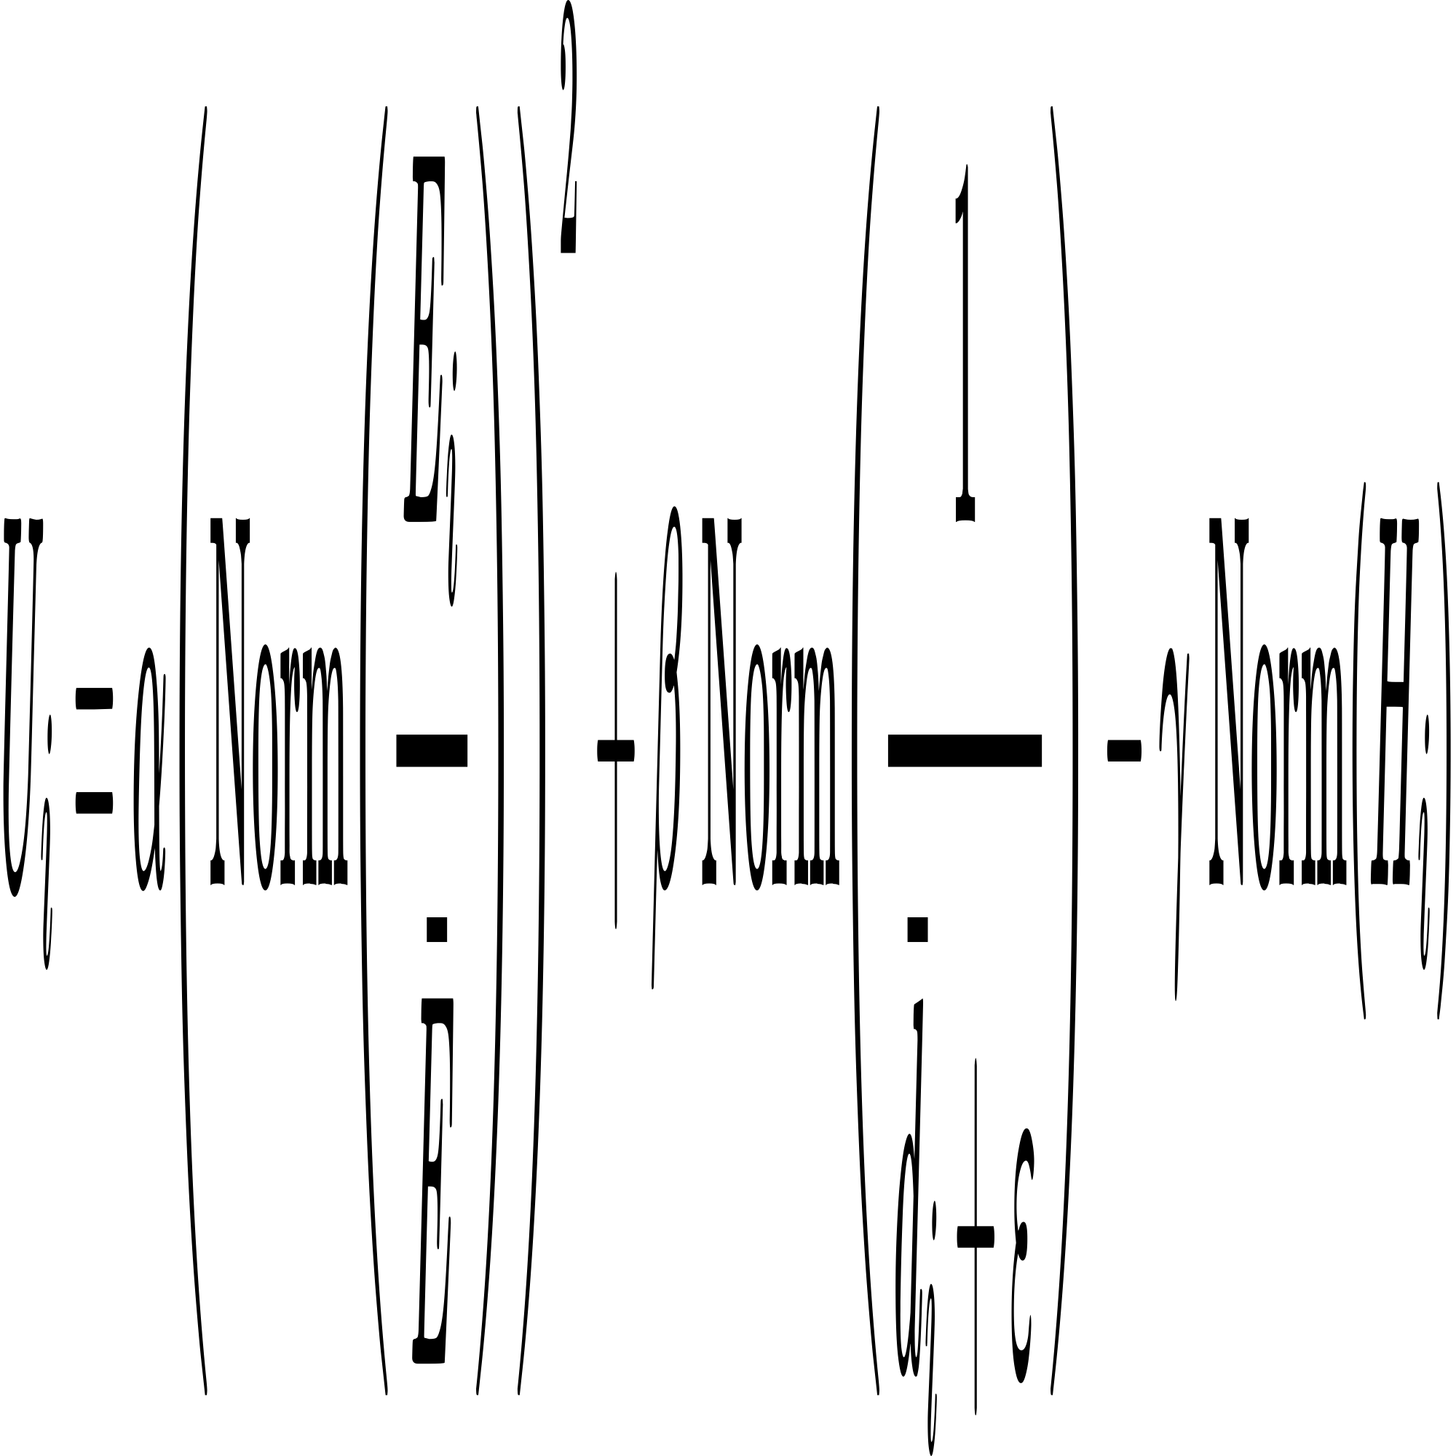
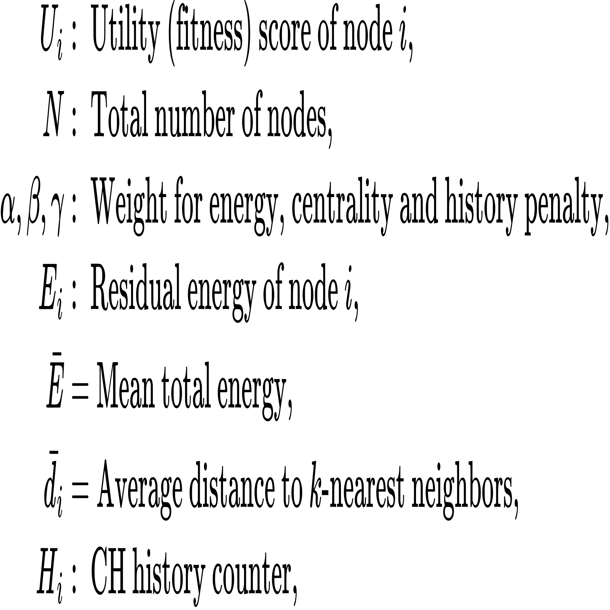
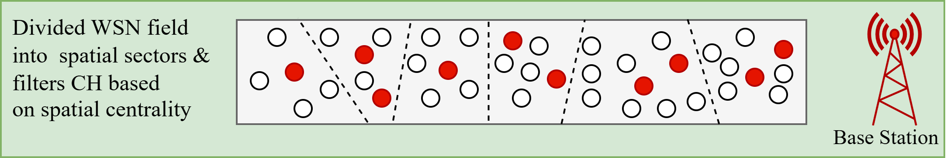
Layer 2: Energy Efficient Knapsack Algorithm
Ensures CH centrality (better positioning)
Maintains spatial diversity among CHs
The core equation that guide EEKA is:
Fig 9: EEK Algorithm
Fig 10: Spatially and centrally distributed CH

Slide 27
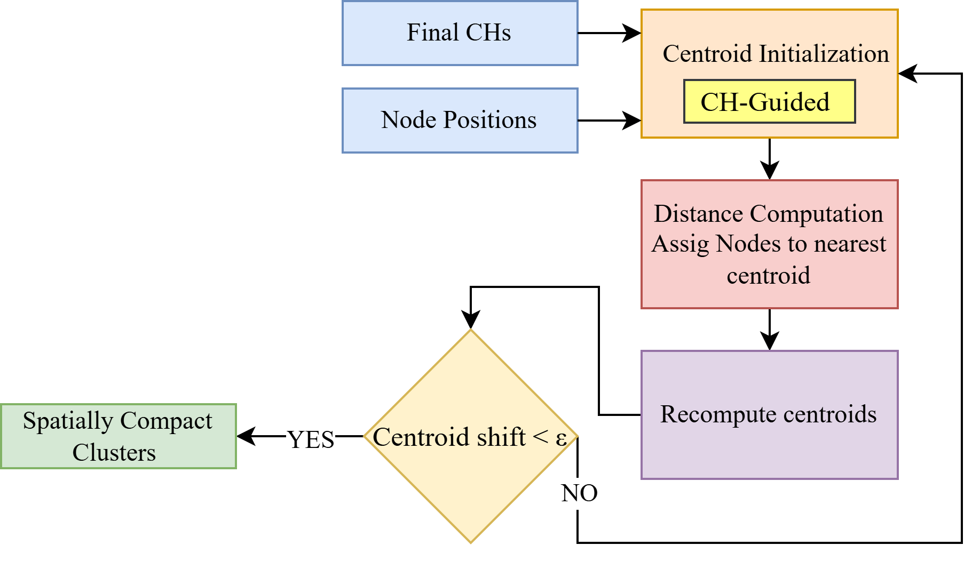
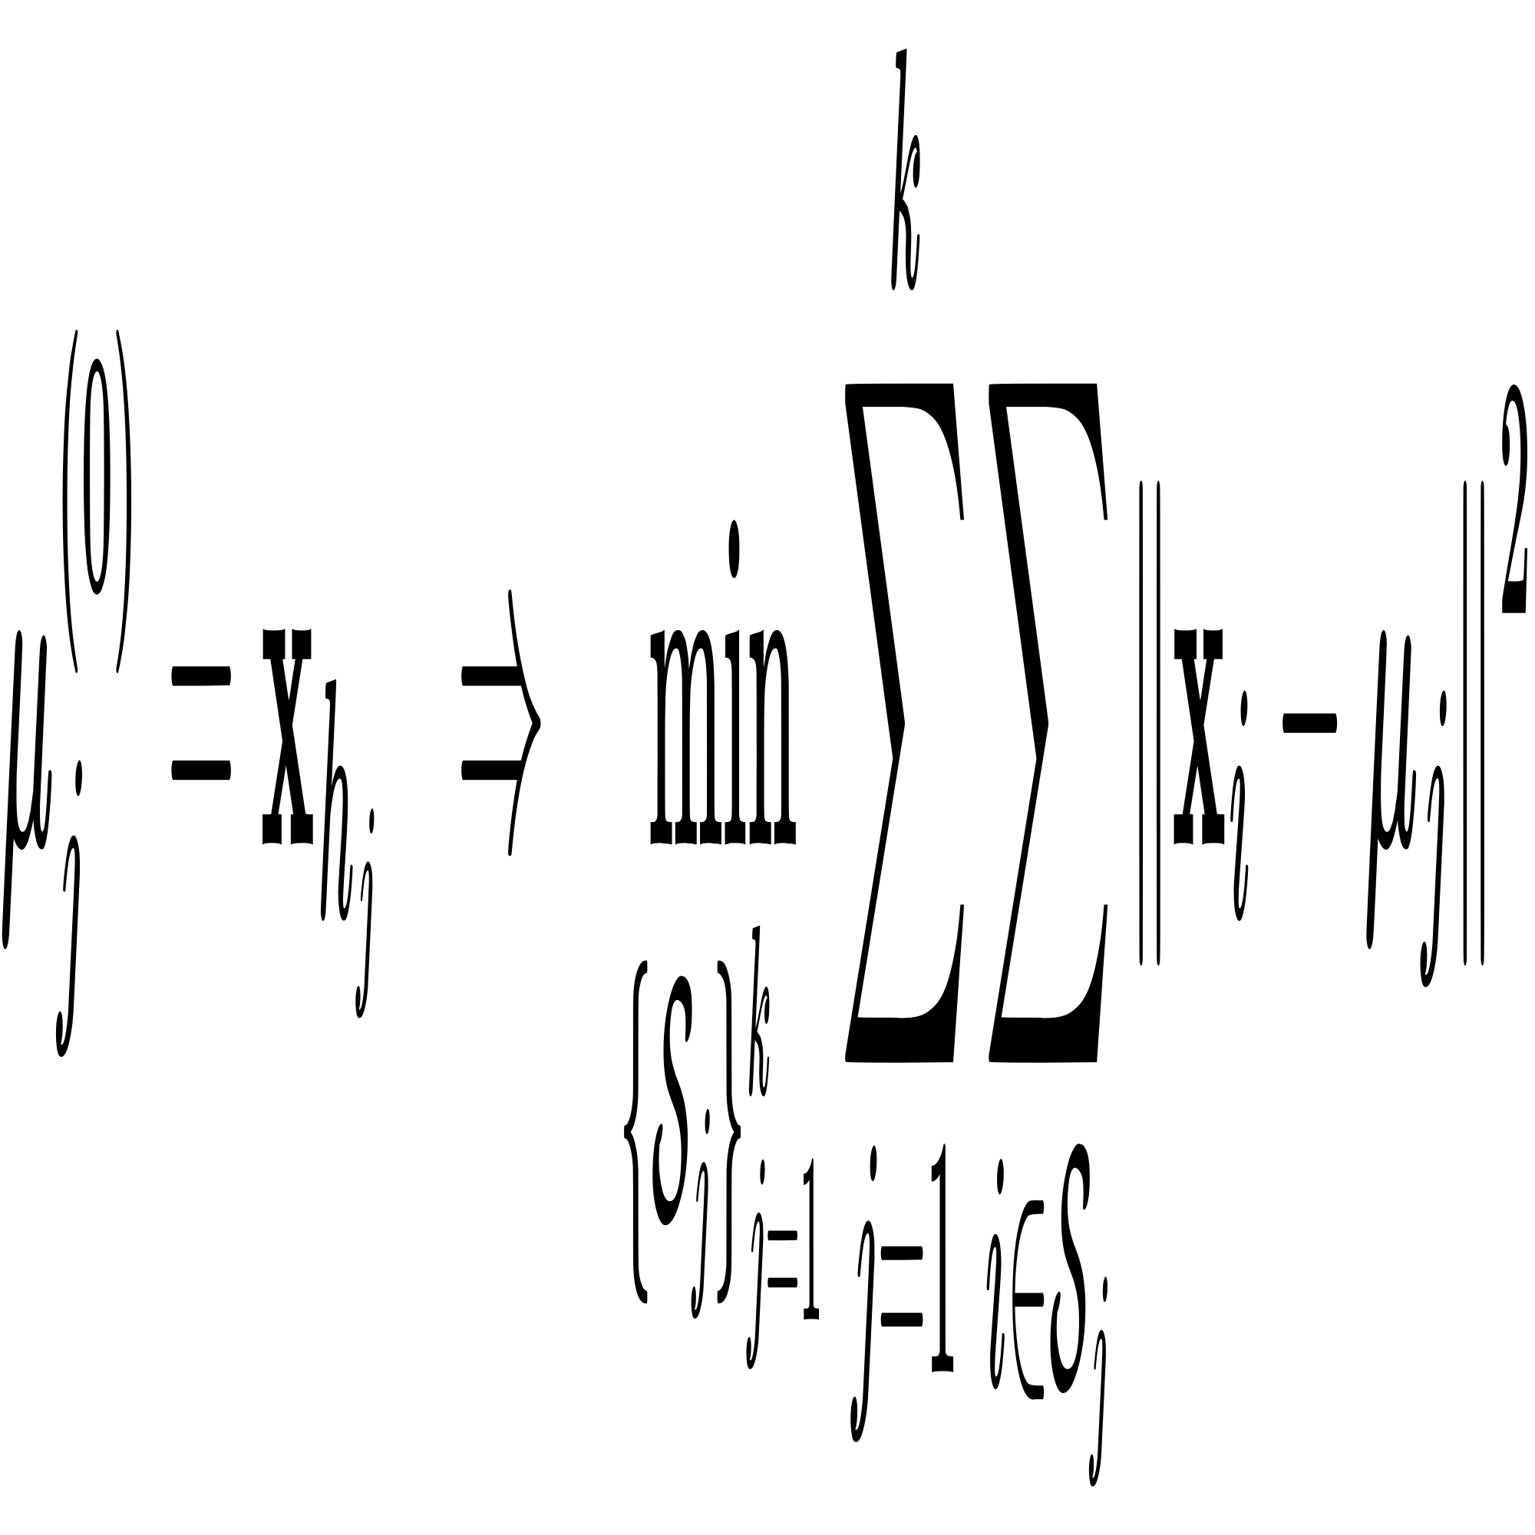
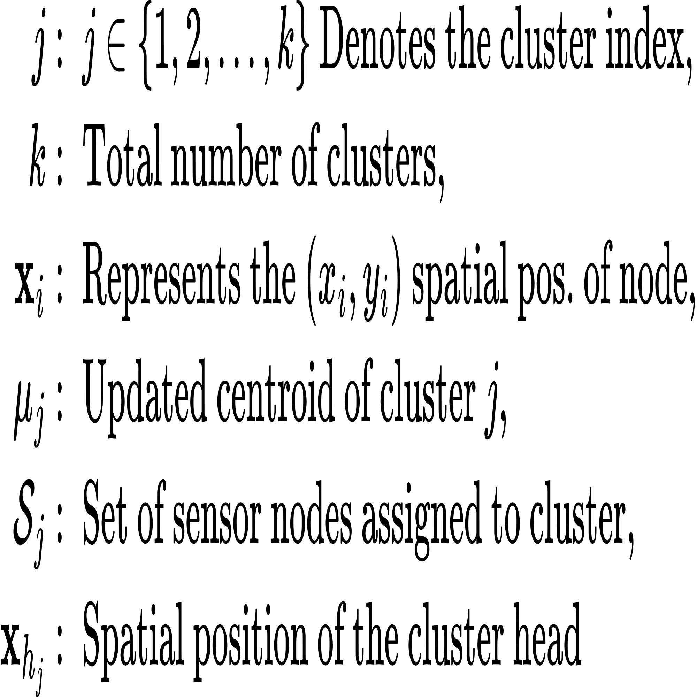
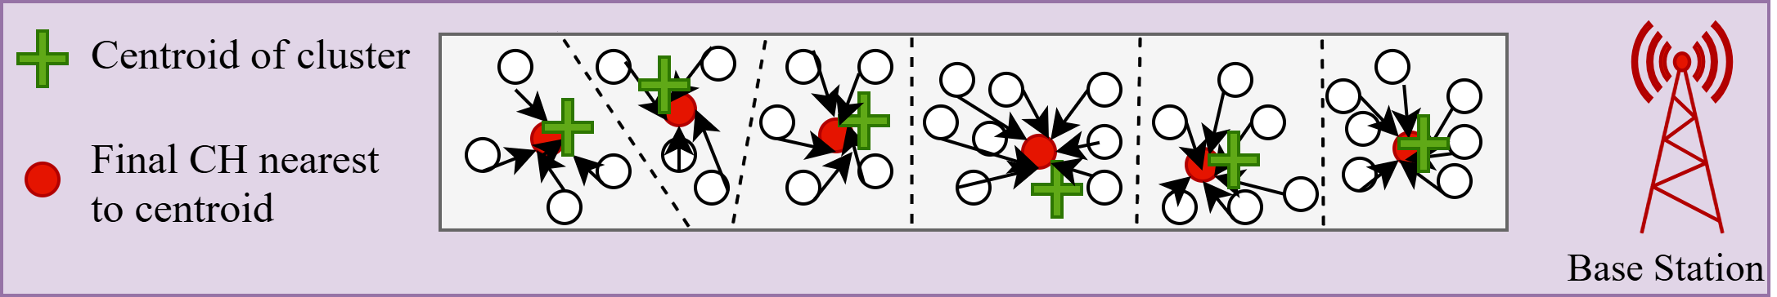
Layer 3: K-Means Algorithm
Clusters nodes into spatially compact groups based on their physical locations.
Reduces the complexity of the RL by enabling cluster level decision making instead of node level control.
The core equation that guide K-Means is:
Fig 9: K-Means Algorithm
Fig 10: Spatially compact cluster

Slide 28
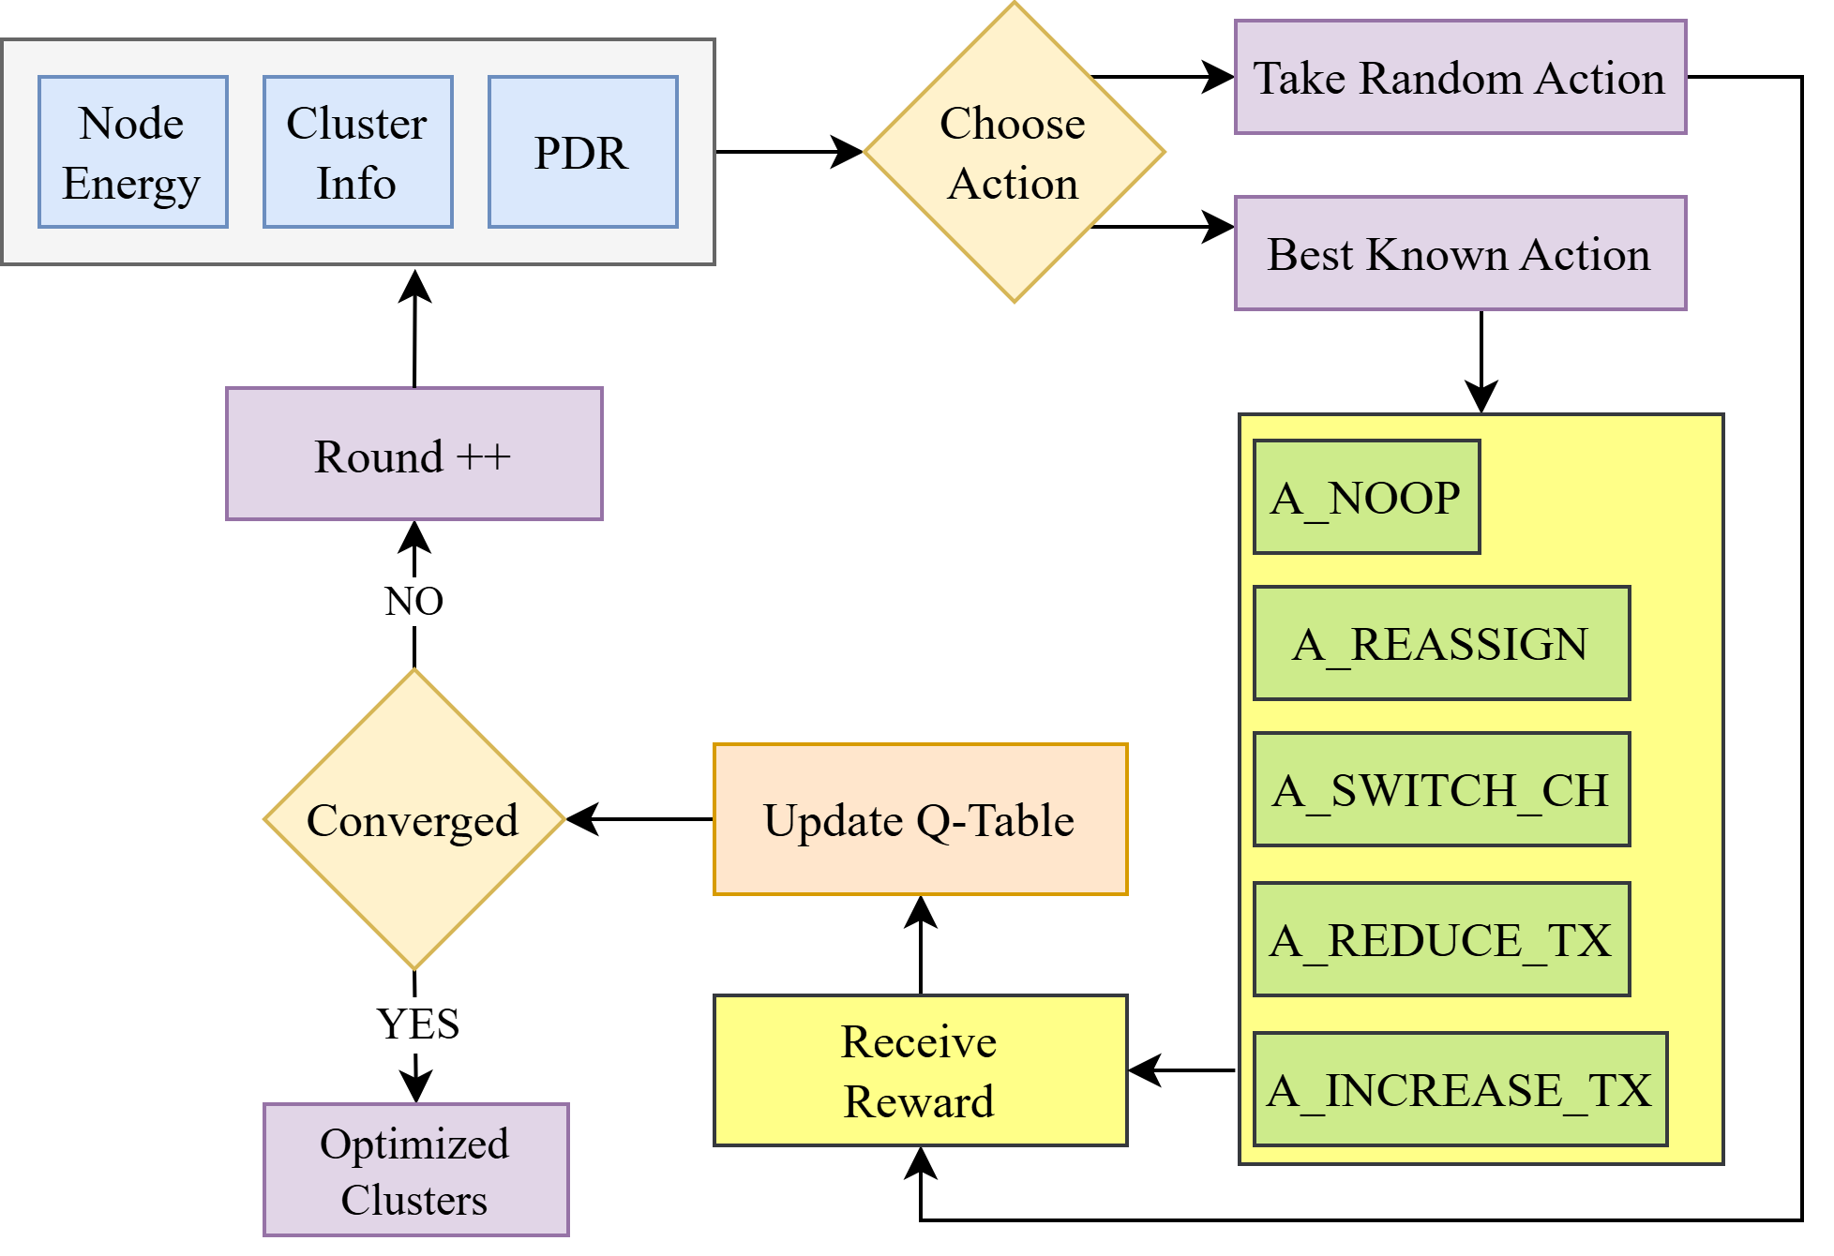
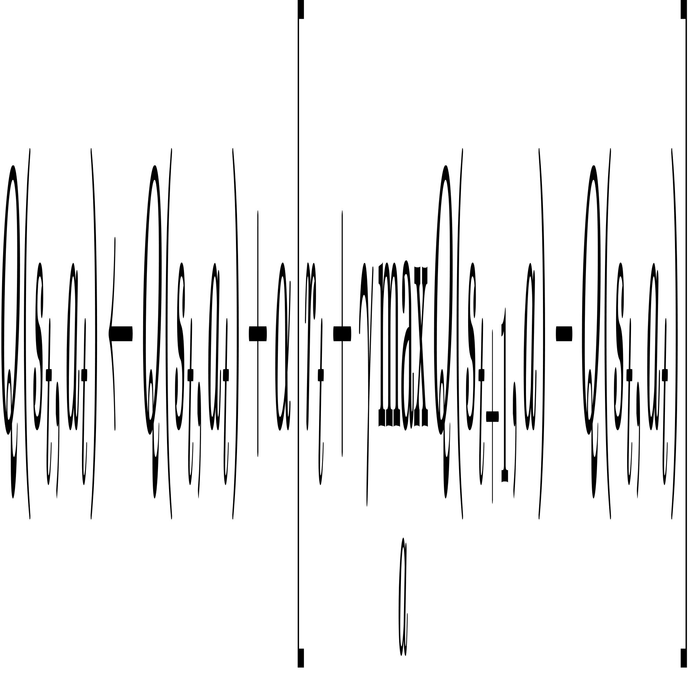
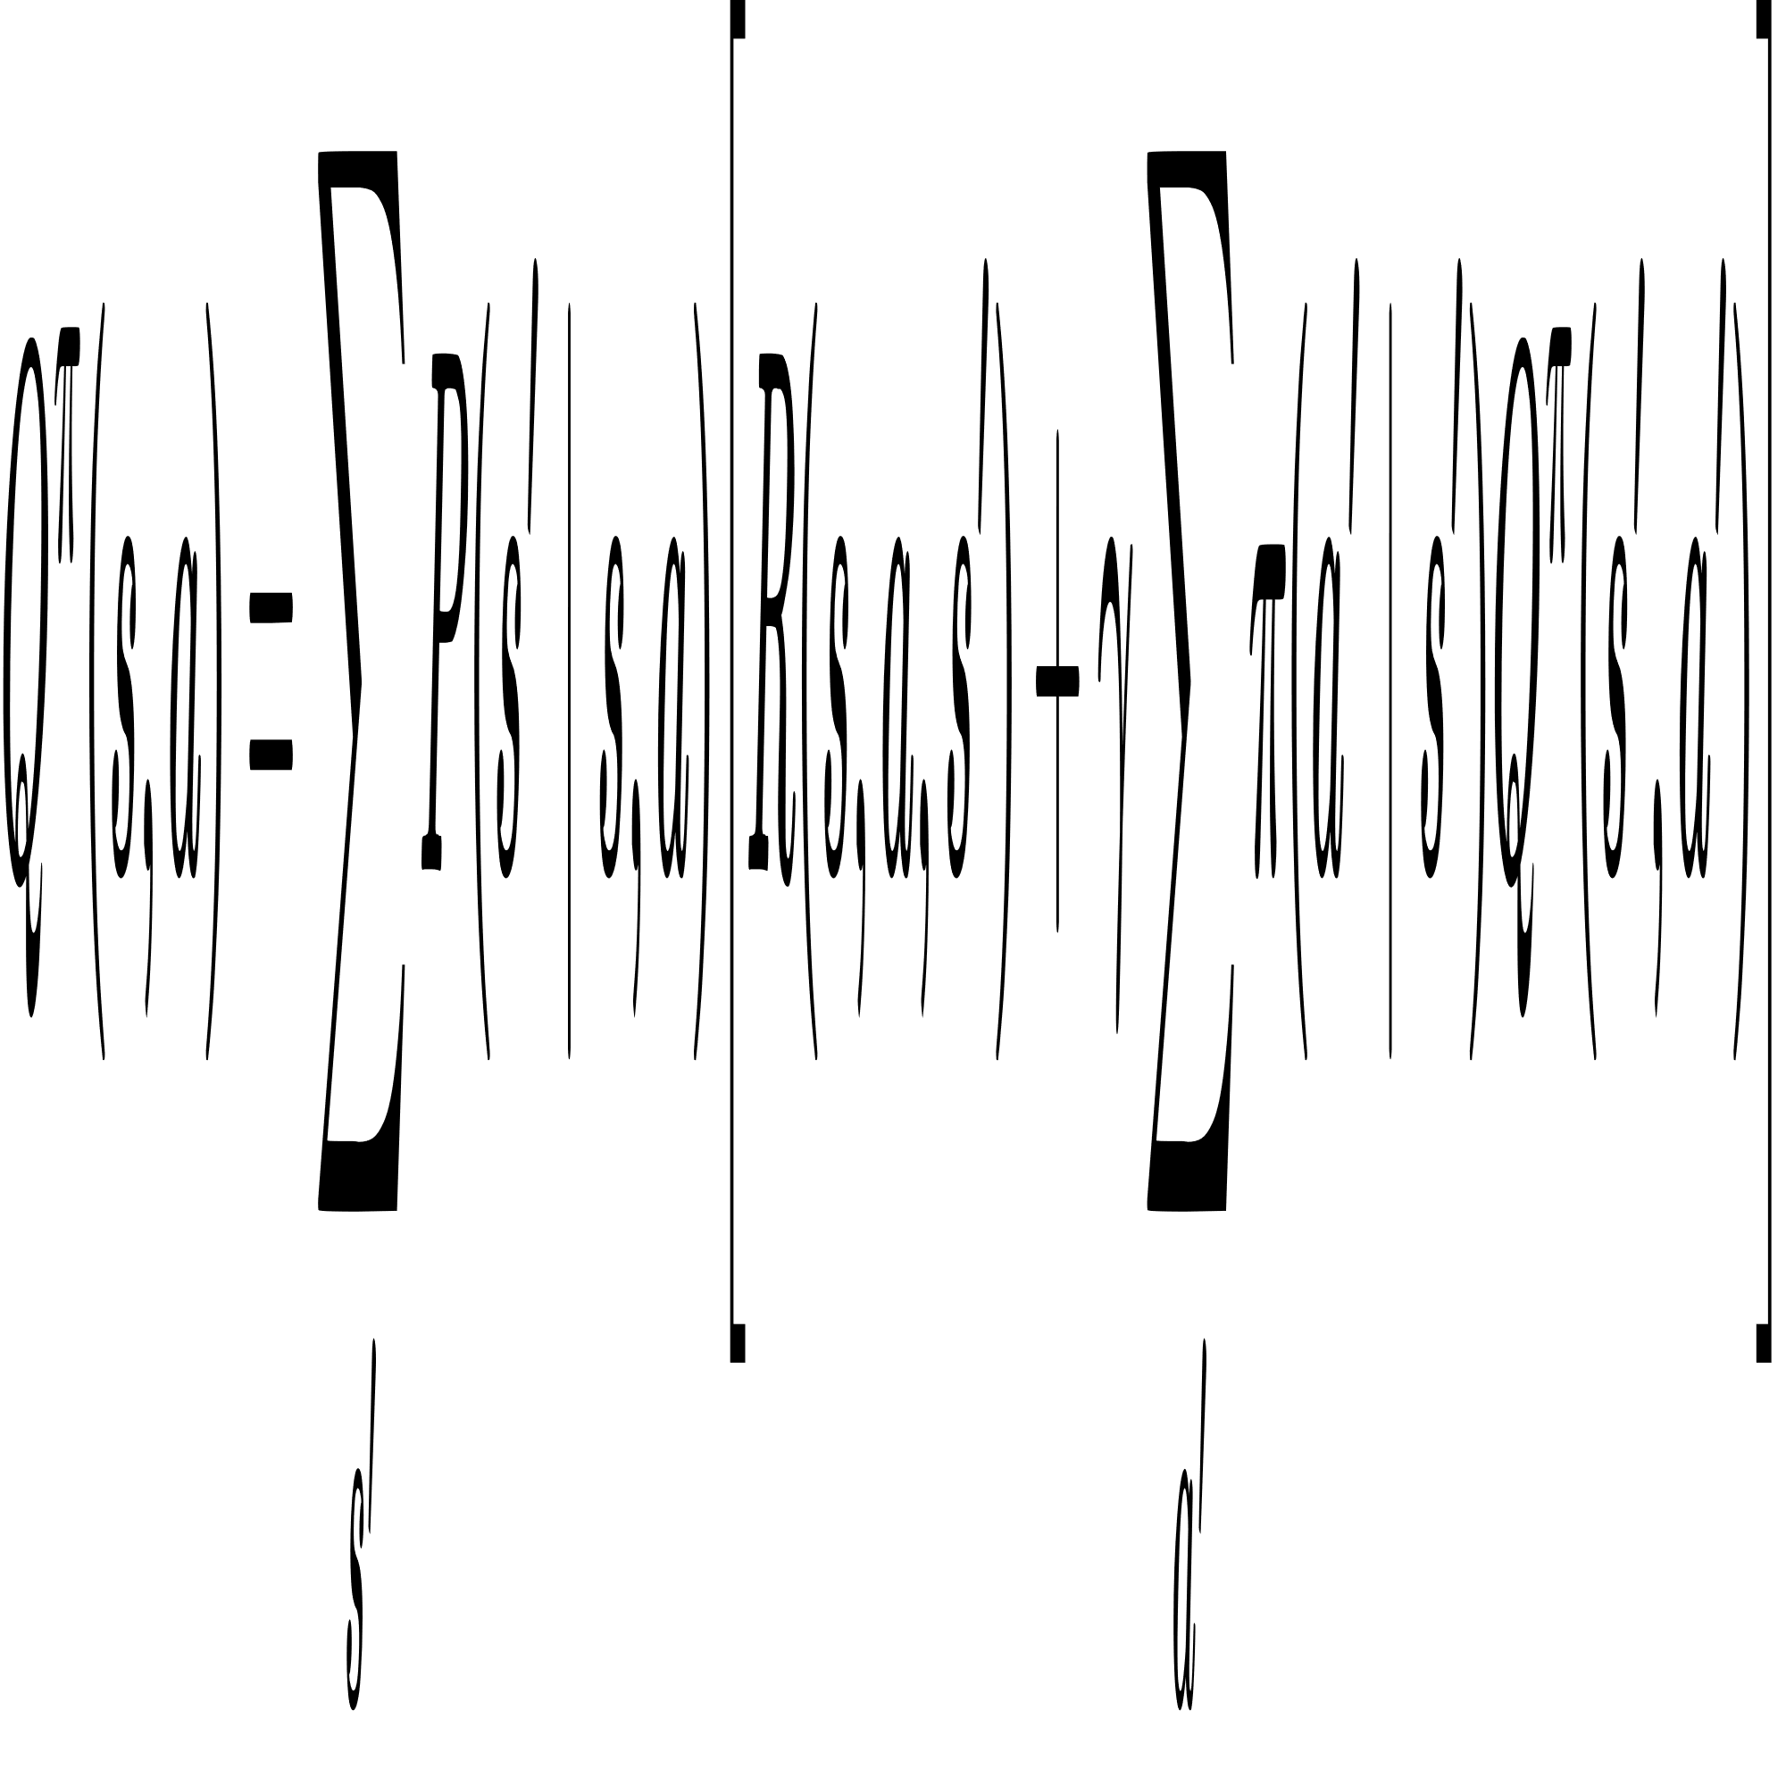
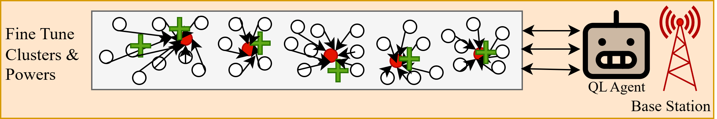
Layer 4: Reinforcement Learning Using Q-Learning
Adaptive decision making by observing network metrics (energy, cluster load, PDR) and chooses adaptive actions.
Learning from feedback by evaluating the outcome of each action using a reward function and updates the Q-table.
Fig 9: RL Algorithm
Above equations are state value function and Q-Table update formula which guide Q-Learning.
Centralized Q-Learning Agent Optimizing Cluster Formation

Slide 29
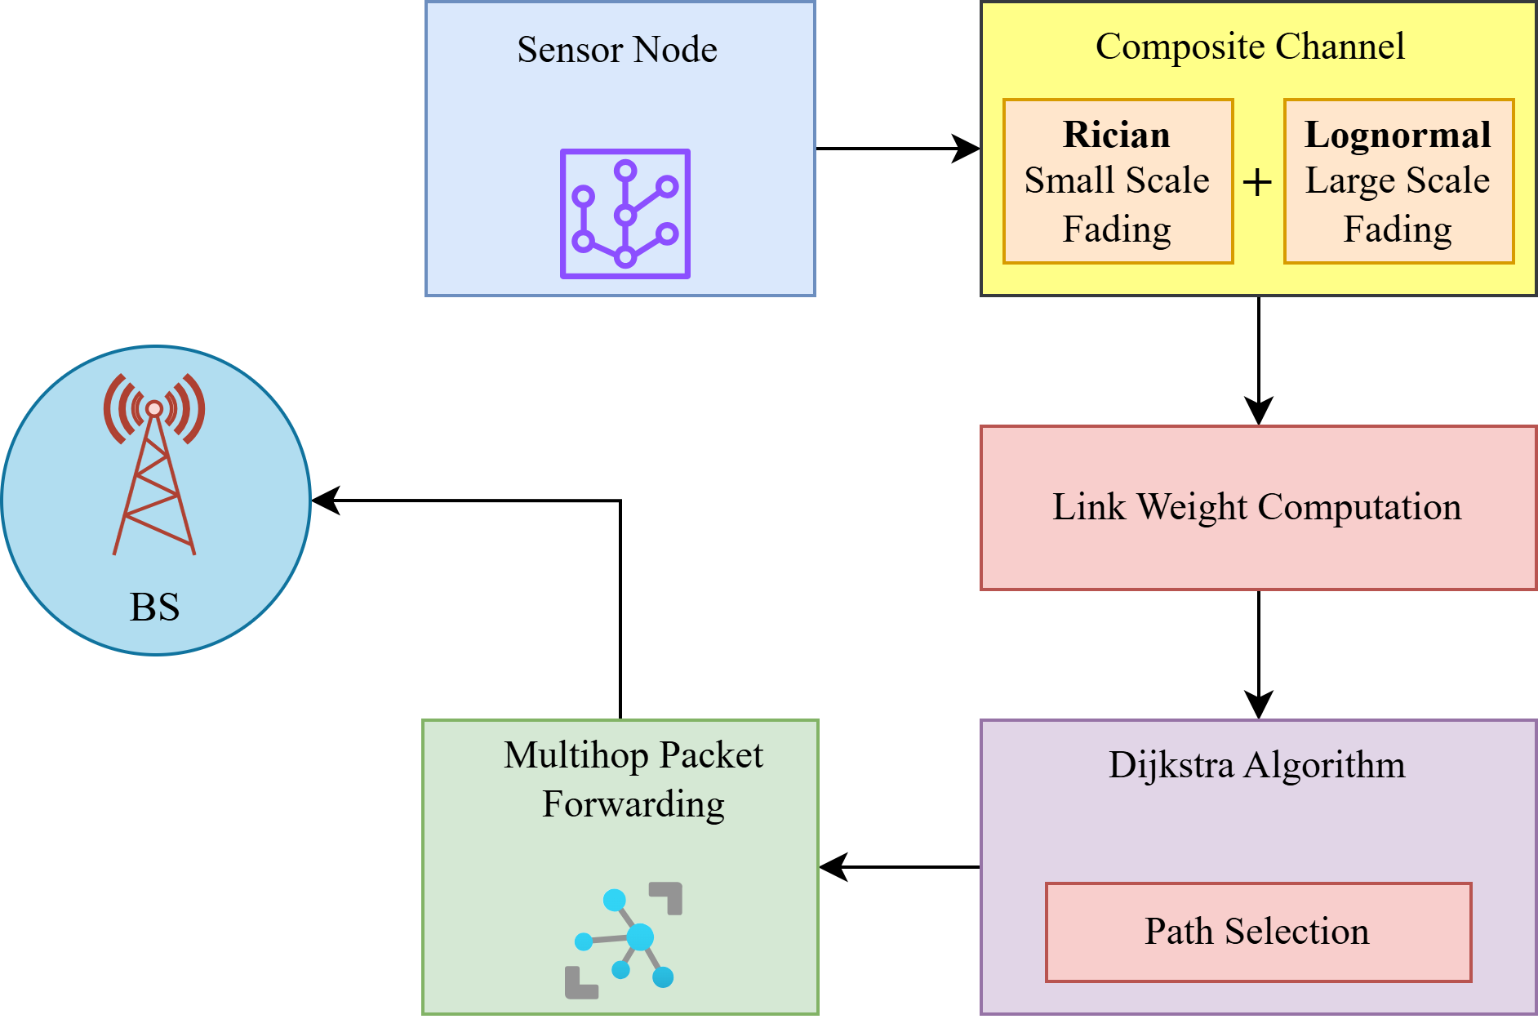
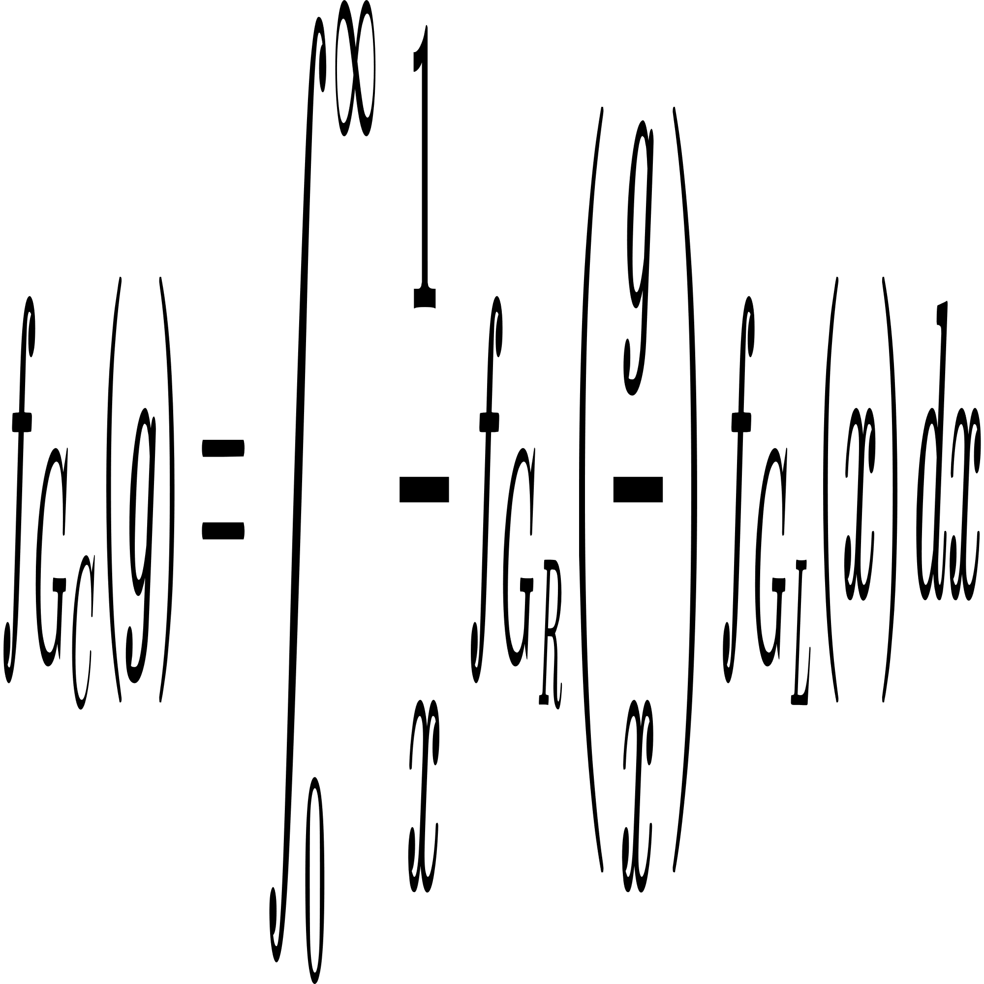
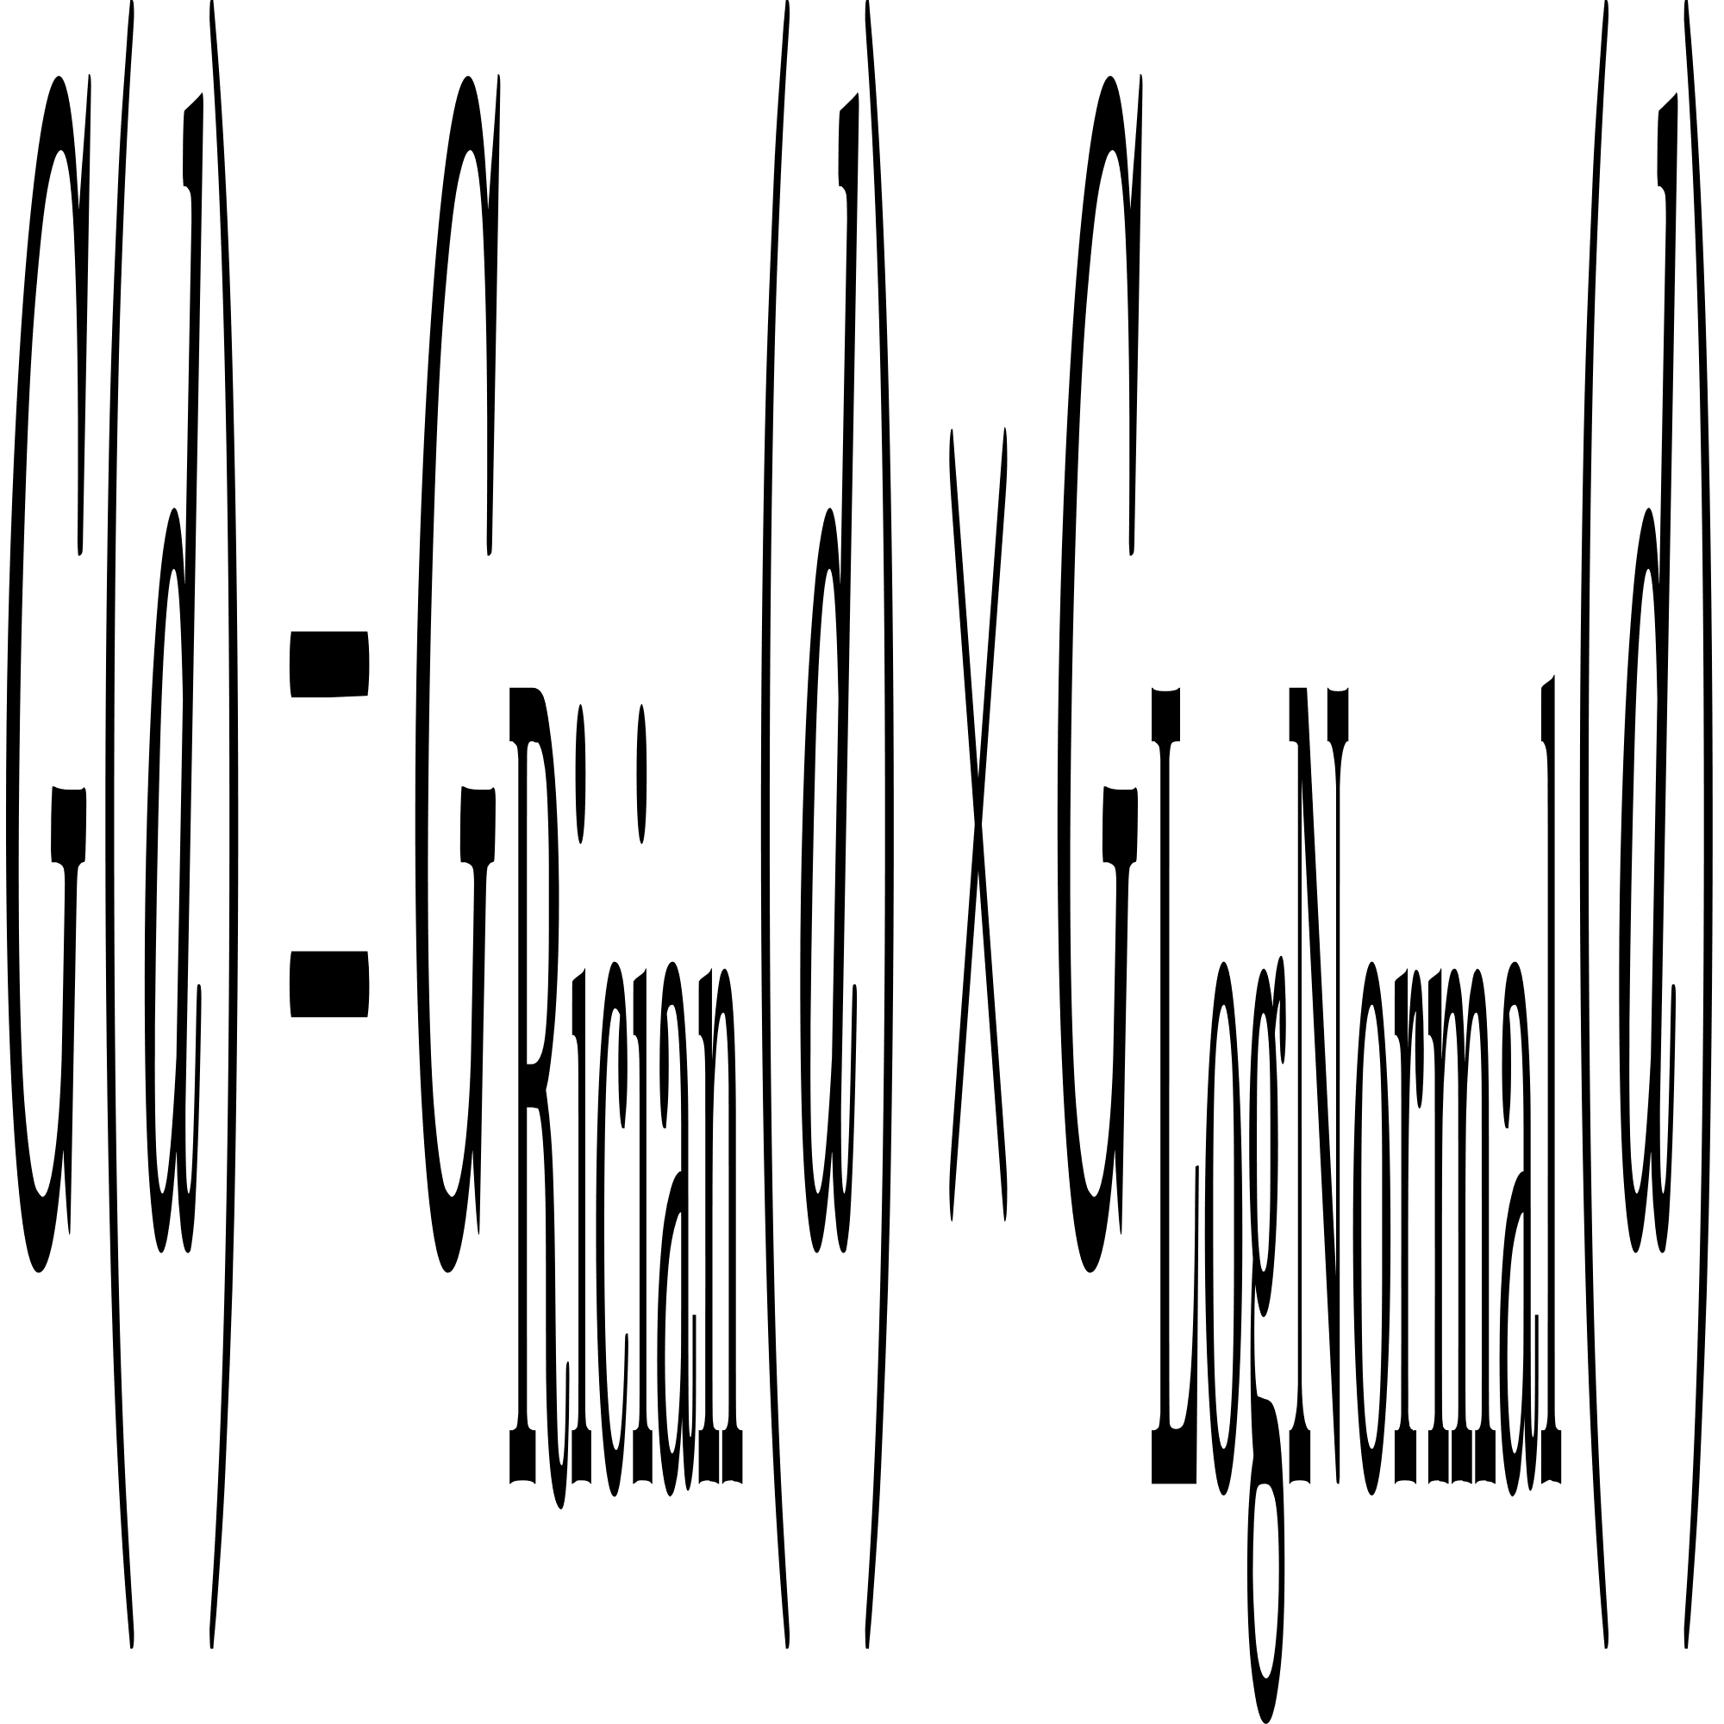
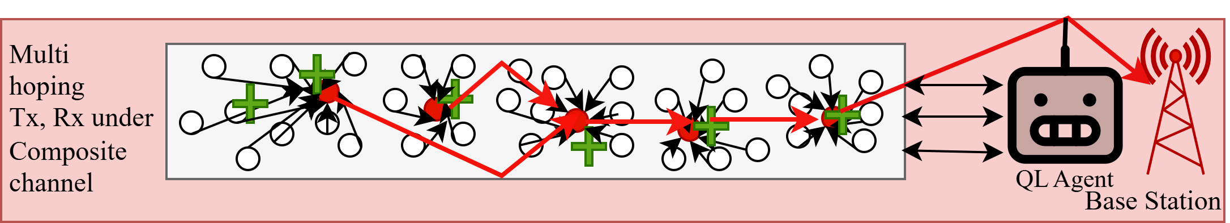
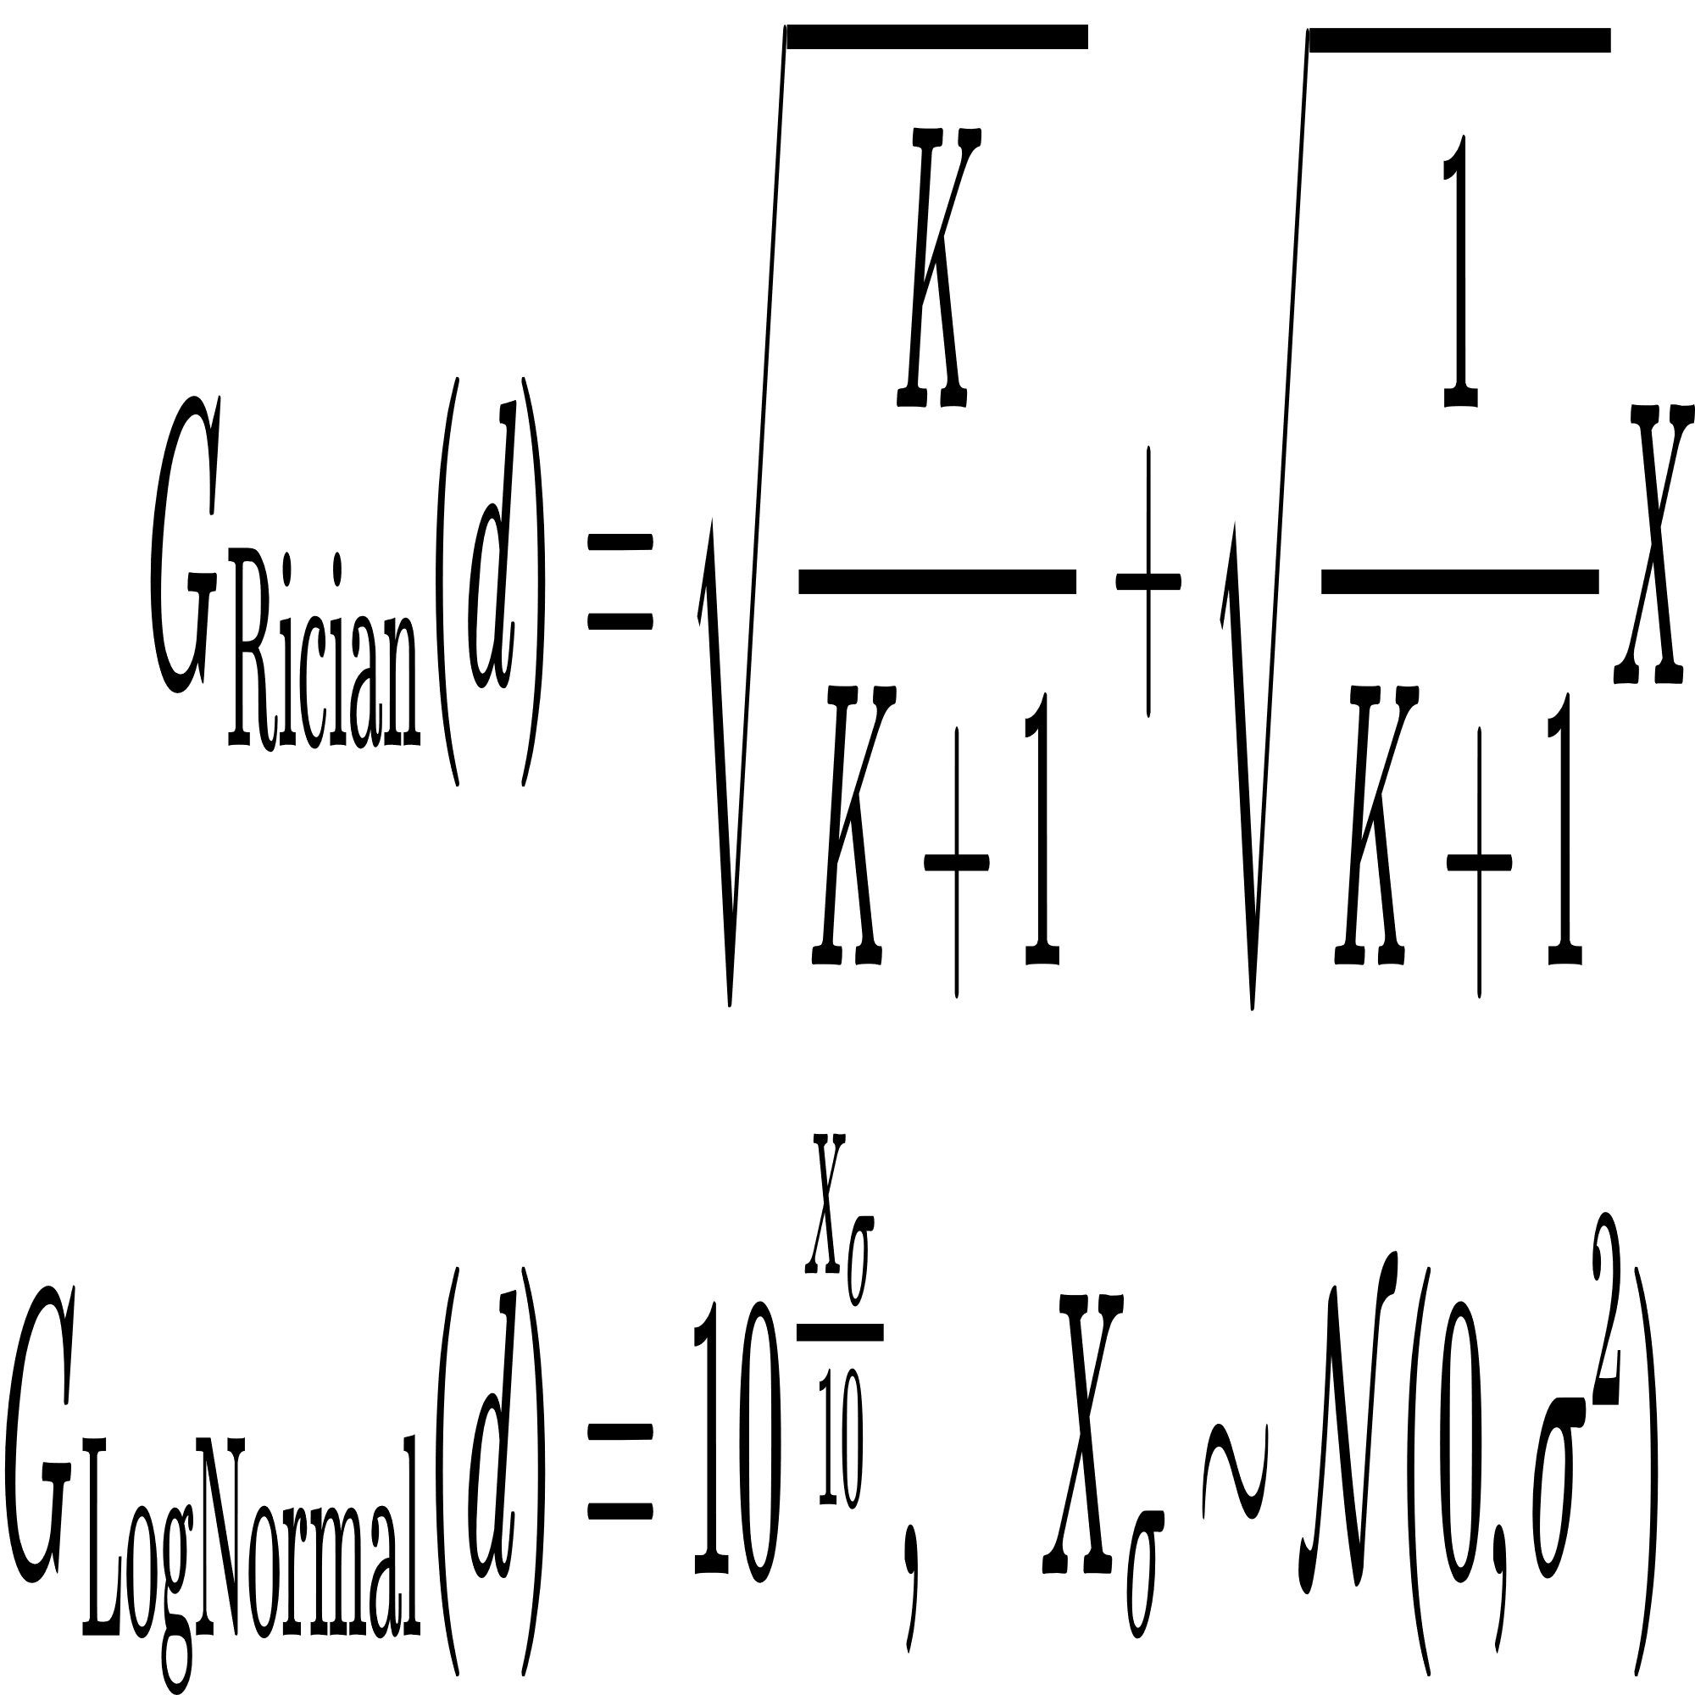
Layer 5: Communication Management
Multihop Routing using Dijkstra Algorithm: Determines the optimal paths for data packets from sensor nodes to the sink.
Uses Rician for small scale variations and Log Normal shadowing for large-scale effects to compute realistic channel link gains.
The core equations which guide Composite channel:
Fig 9: Communication
Fig 10: Multihopping communication under composite channel

Slide 30
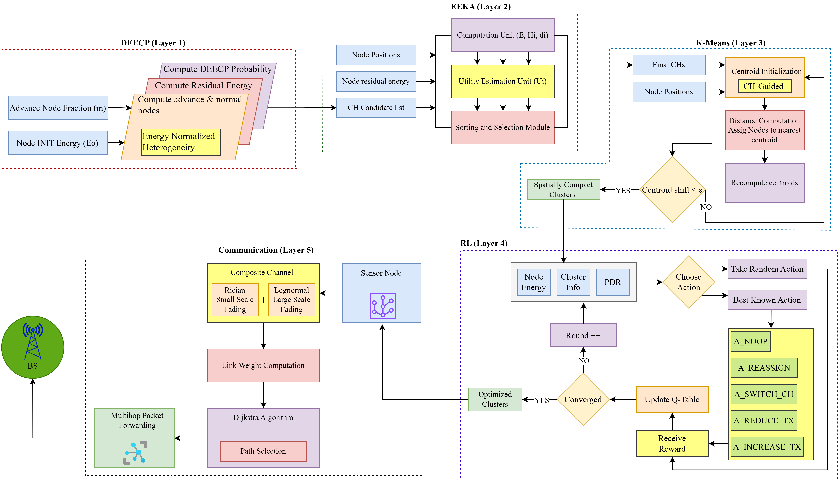
Fig 10: End-to-End Layer Integration

Slide 31
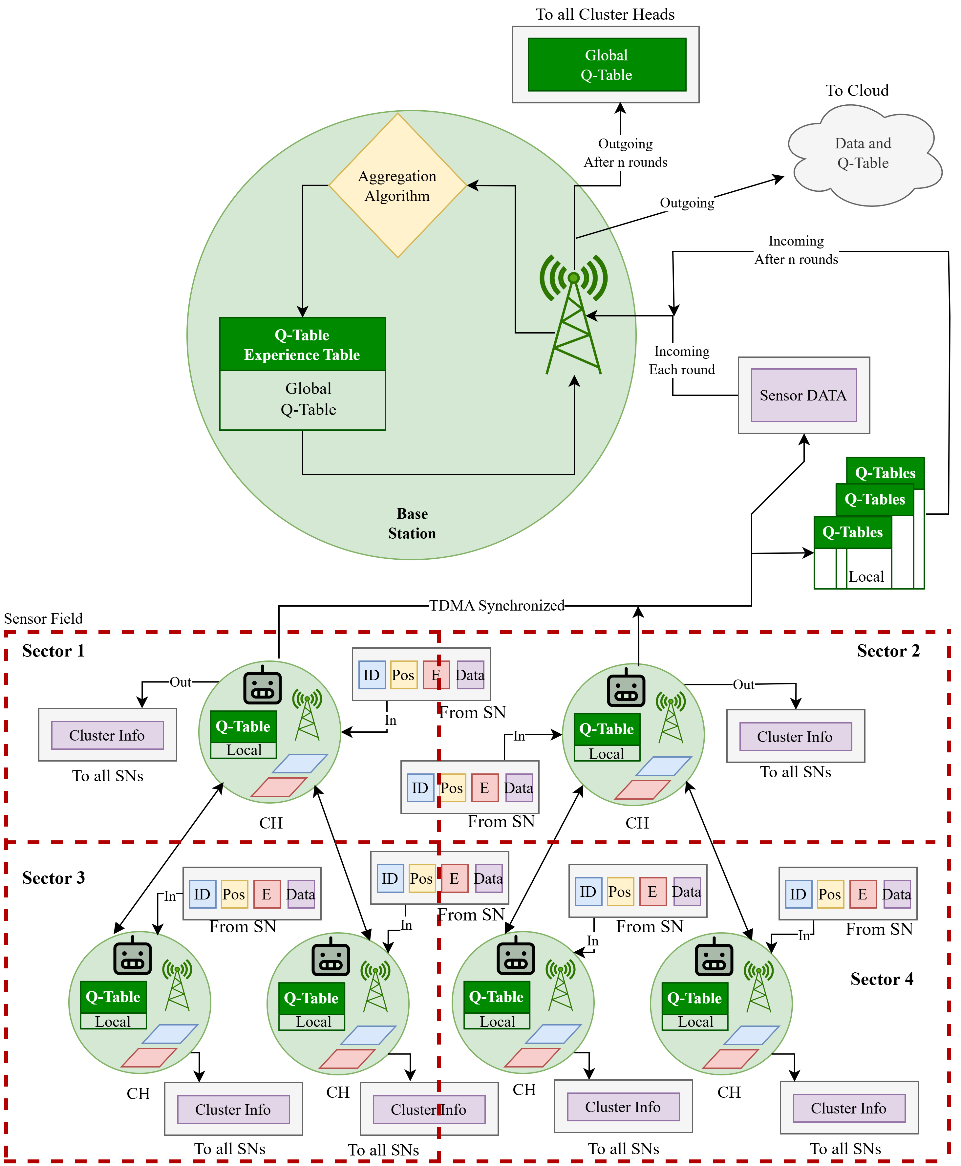
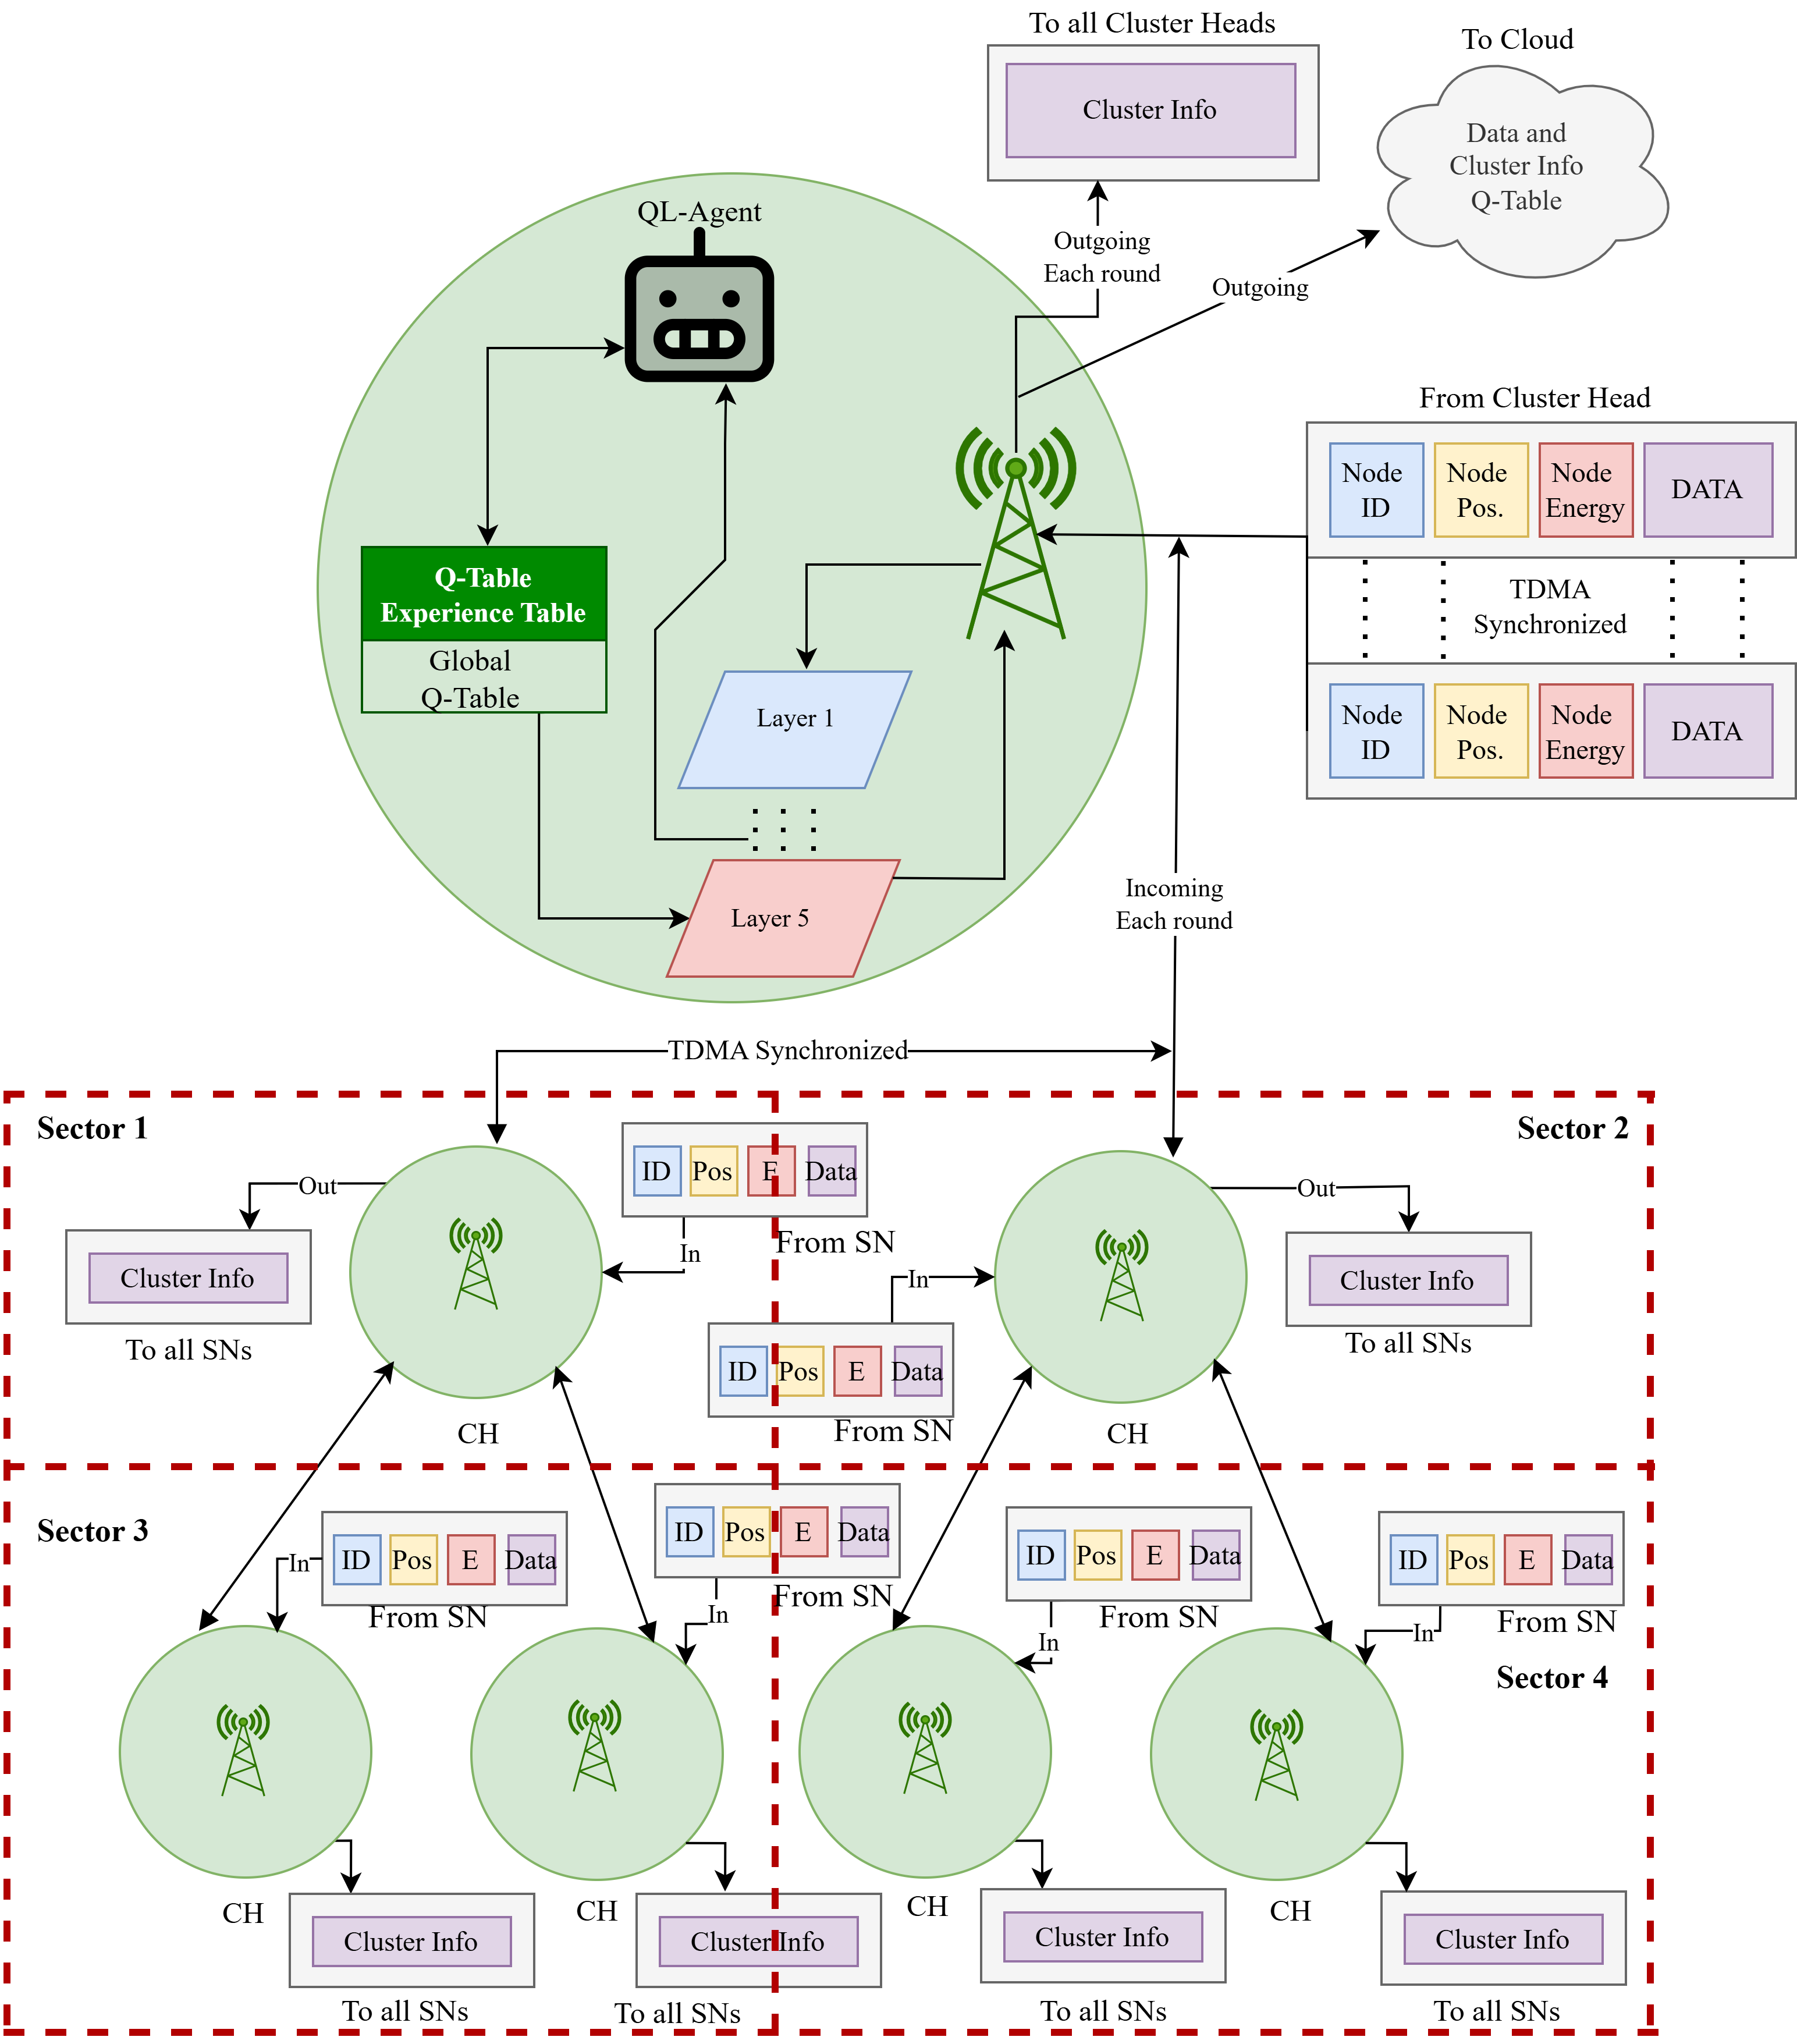
Fig 10: Federated Q-learning
Fig 11: Centralized Q-learning

Slide 32
Simulation Environment
Network Parameters | Value
WSN area size | 1000m x 1000m
Initial energy | 2 Joules
Number of Sensor Nodes | 150
Packet size | 128 bytes (1024 bits)
Data aggregation energy | 5n J/bit/signal
Transmit energy | 50n J/bit
Receive energy | 50n J/bit
Free space loss | 10n J/bit
Multipath loss | 0.0013p J/bit
Base Station Mobility | Fixed / Mobile
Network Type | Heterogeneous WSN
Simulation Rounds | 1000-4000
Node and Sink Model | Value
Node Mobility | Random Walk
Maximum Node Speed | 1 m/s
Sectorization | 3 × 3 grid (9 sectors)
Underground Channel Model | Value
Channel Type | Composite channel
Operating Frequency | 865 MHz (LoRa)
Noise Power | −95 dBm
Application/Software | Version
Python | 3.11.1
Antigravity | A1

Slide 33
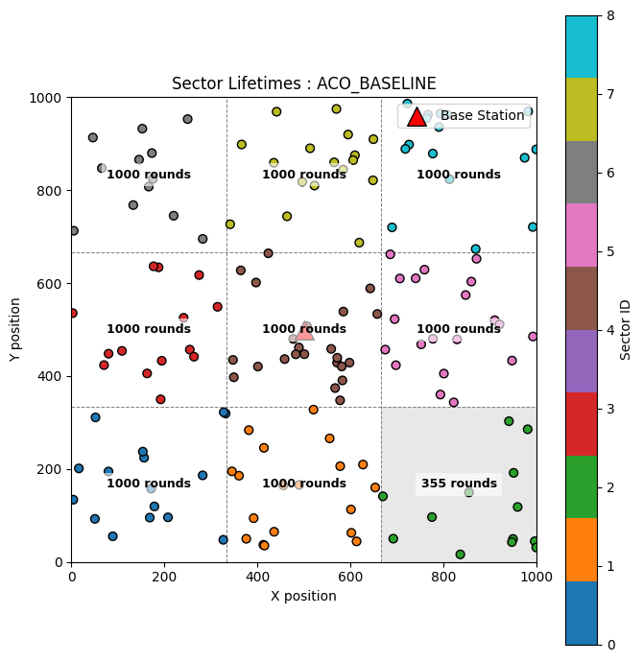
Simulation Animation
This animation illustrates the dynamic behavior of the wireless sensor network over successive simulation rounds.
It shows cluster head rotation, sector wise operation and multi-hop routing and manages the node mobility
Fig 10: RLHC (CEN) simulation

Slide 34
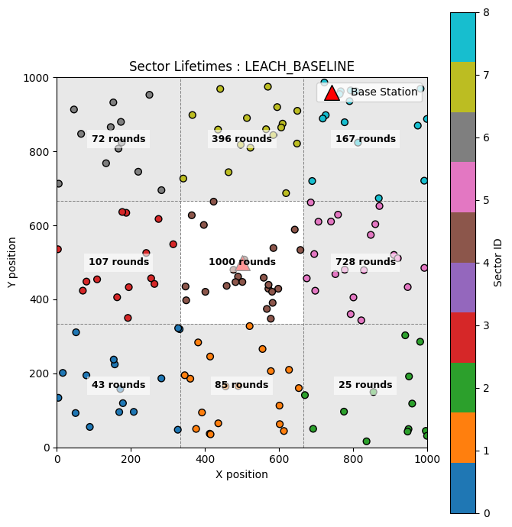
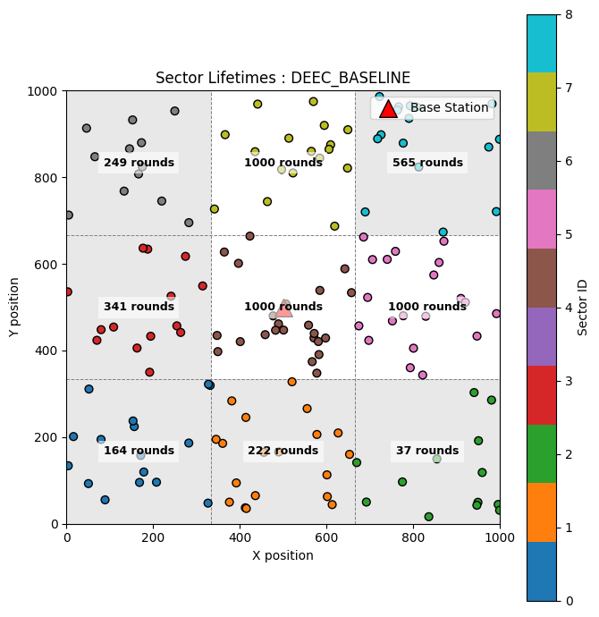
Simulation Results
Fig 10: Sector-wise survival in LEACH
Fig 10: Sector-wise survival in DEECP

Slide 35
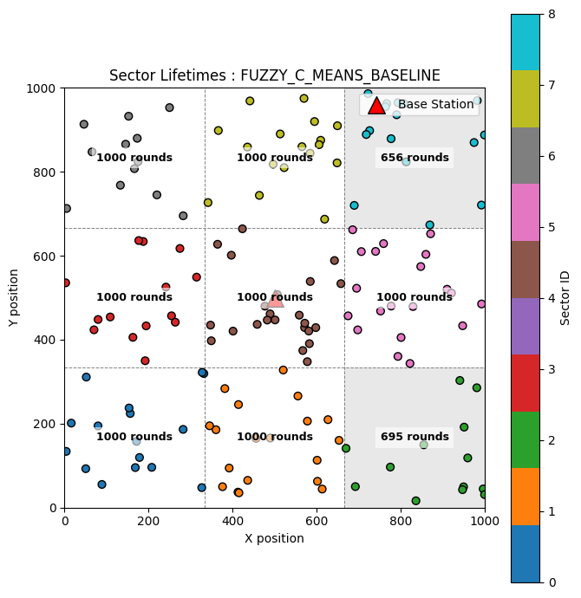

Simulation Results
Fig 10: Sector-wise survival in FCM
Fig 10: Sector-wise survival in PSO

Slide 36
Simulation Results
Fig 10: Sector-wise survival in FCM

Slide 37
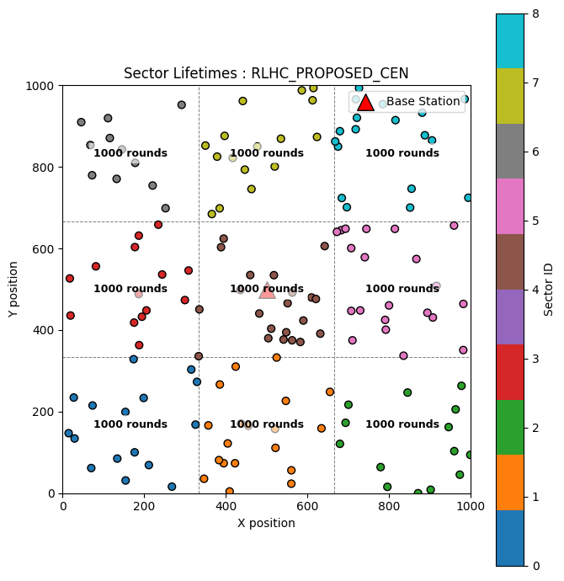
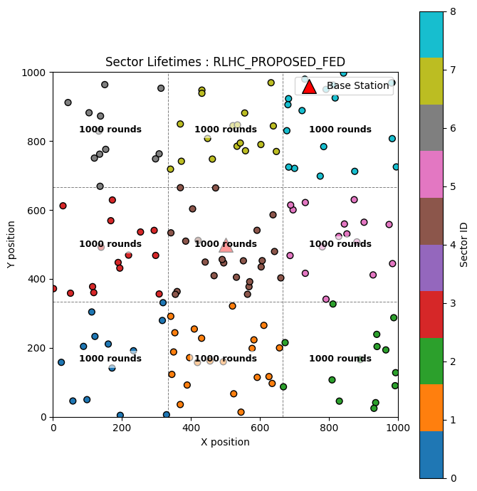
Simulation Results
Fig 10: Sector-wise survival in RLHC (Centralized)
Fig 10: Sector-wise survival in RLHC (Federated)

Slide 38
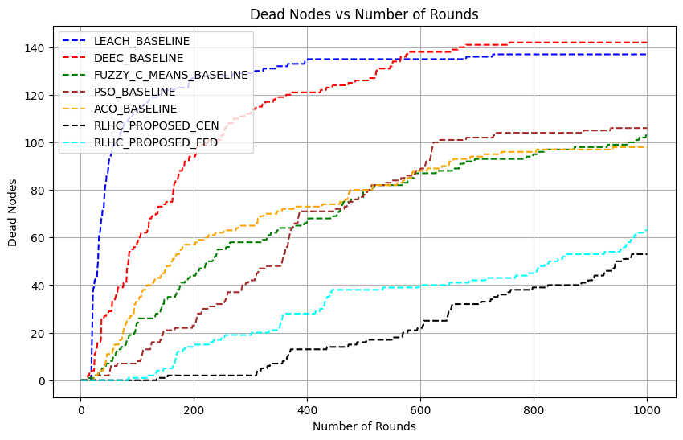
Simulation Results
Fig 10: Network lifetime in terms of node death

Slide 39
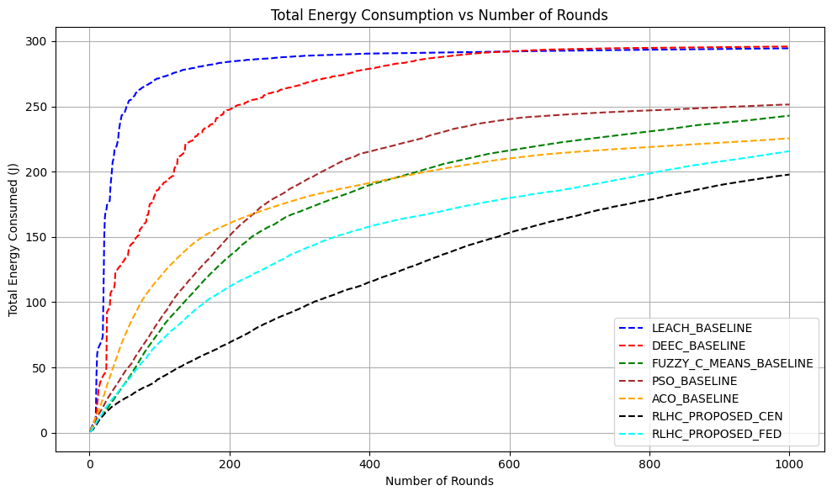
Simulation Results
Fig 10: Total Energy Consumption

Slide 40
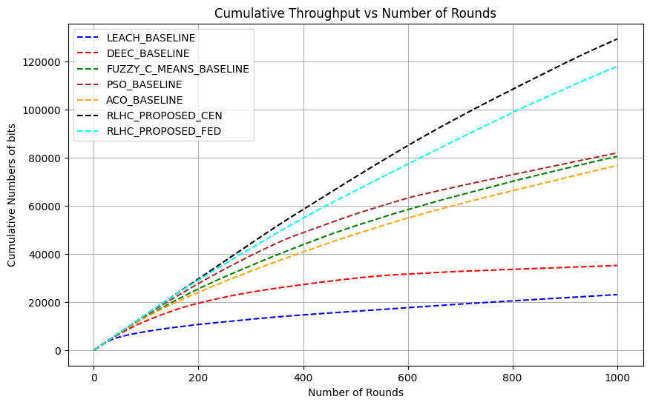
Simulation Results
Fig 10: Total Throughput

Slide 41

Simulation Results
Fig 10: PDR

Slide 42

Simulation Results
Fig 10: Q-Learning Reward

Slide 43

Simulation Results
Fig 10: Q-Learning Reward variation from previous round

Slide 44


Simulation Results
Fig 10: Sector-wise survival in RLHC (CEN)
Fig 10: Sector-wise survival in RLHC (FED)

Slide 45

Simulation Results
Fig 10: Network lifetime in terms of node death

Slide 46

Simulation Results
Fig 10: Total Energy Consumption

Slide 47

Simulation Results
Fig 10: Total Throughput

Slide 48

Simulation Results
Fig 10: PDR

Slide 49

Simulation Results
Fig 10: Q-Learning Reward

Slide 50

Simulation Results
Fig 10: Q-Learning Reward variation from previous round

Slide 51
References
[1] Online Data Source: Directorate General of Mines Safety (DGMS) - https://www.dgms.gov.in
[2] Online Data Source: https://www.assocham.org/uploads/files/Study_Indian%20Mineral%202022.pdf
[3] S. Saha, S. C. Bakshi, A. Pramanik and R. Lakshmanan, "On Underground Coal Mine Environment Monitoring with LoRa Range Extension," 2023 5th International Conference on Energy, Power and Environment: Towards Flexible Green Energy Technologies (ICEPE), Shillong, India, 2023, pp. 1-6, doi: 10.1109/ICEPE57949.2023.10201552.
[4] M. Amanzadeh, S. M. Aminossadati, M. S. Kizil, E. Sheridan and W. P. Bowen, "A microfabricated fibre optic sensor for methane gas measurement in underground coal mines," 2012 Photonics Global Conference (PGC), Singapore, 2012, pp. 1-5, doi: 10.1109/PGC.2012.6457999
[5] B. R. Al-Kaseem, Z. K. Taha, S. W. Abdulmajeedand H. S. Al-Raweshidy, “Optimized energy–efficient path planning strategy in WSN with multiple mobile sinks,” IEEE Access, vol. 9, pp. 79994–80007, Jun. 2021, doi: 10.1109/ACCESS.2021.3087086
[6] R. Alsaqour, E. S. Ali, R. A. Mokhtar, R. A. Saeed, H. Alhumyaniand M. Abdelhaq, “Efficient energy mechanism in heterogeneous WSNs for underground mining monitoring applications,” IEEE Access, vol. 10, pp. 100123–100138, Jul. 2022, doi: 10.1109/ACCESS.2022.3188654.
[7] F. M. Salman, A. A. Mohammedand A. F. Mutar, “Optimization of LEACH protocol for WSNs in terms of energy efficiency and network lifetime,” Journal of Cyber Security and Mobility, IEEE vol. 12, no. 3, pp. 275–296, May 2023, doi: 10.13052/jcsm2245-1439.1232.

Slide 52
References
[8] M. Gamal, N. E. Mekky, H. H. Solimanand N. A. Hikal, “Enhancing the lifetime of wireless sensor networks using fuzzy logic LEACH technique-based particle swarm optimization,” IEEE Access, vol. 10, pp. 36935–36948, Mar. 2022, doi: 10.1109/ACCESS.2022.3163254.
[9] S. Mohapatra, P. K. Behera, P. K. Sahoo, S. K. Bisoy “Mobility induced multi-hop LEACH protocol in heterogeneous mobile network,” IEEE Access, vol. 10, pp. 132895–132907, Dec. 2022, doi: 10.1109/ACCESS.2022.3228576.
[10] Zhu, B., Bedeer, E., Nguyen, H. H., Barton, R., & Henry, J. (2022). “UAV Trajectory Planning in Wireless Sensor Networks for Energy Consumption Minimization by Deep Reinforcement Learning”. IEEE Transactions on Vehicular Technology, 70(9), 9540–9554. doi:10.1109/TVT.2021.3102161
[11] Abose, T. A., Tekulapally, V., Kejela, D. C., Megersa, K. T., Daka, S. T., & Jember, K. A. (2024). “Optimized Cluster Routing Protocol With Energy-Sustainable Mechanisms for Wireless Sensor Networks.” IEEE Access, 12, 99661-99671. doi:10.1109/ACCESS.2024.3429645
[12] Chowdhury, A. R., Bakshi, S. C., Pramanik, A., & Roy, G. C. (2024). “Design and Study of LoRa-Based IIoT Network for Underground Coal Mine Environment.” IEEE Access. DOI: 10.1109/ACCESS.2024
[13] Abdul Aleem & Rajesh Thumma “Optimizing Energy Efficiency in IoT-Enabled Wireless Sensor Networks Using an Integrated EEKA-K-means Approach” by EEE Sensors Journal, 2025. DOI: 10.1109/JSEN.2025.3582381
[14] Chaudhari, A., Deshpande (2025). Energy-efficient Q-learning-based routing in wireless sensor networks. International Journal on Smart Sensing and Intelligent Systems, https://doi.org/10.2478/ijssis-2025-0008
[15] Available Online Book : https://web.stanford.edu/class/psych209/Readings/SuttonBartoIPRLBook2ndEd.pdf

Slide 53
Thank You
Open to Q&A

